Slide 1
NCMRG Training

Slide 2
Welcome and Prayer
Colette Stevenson

Slide 3
Aims for the Day
To update you on the work of the NCMRG and update you on emerging themes from cases.
To present information on these recurring themes including:
Recovered memory
Canonical process
Assessments
3. To hear from you an issues you have in relation to these themes or others.

Slide 4
Key Times
Break- 11.30-11.45
Lunch 12.45-1.45
Finish 3.35

Slide 5
Update on the Work and Emerging Themes
Teresa Devlin

Slide 6
History and Members
Established in September 2011
First year up to January 2013 on a pilot basis with independent evaluation
Initially 19 members
Now 44 Members from Dioceses and Religious Congregations

Slide 7
Members of Panel
Chair – Sister Colette Stevenson
Teresa Devlin (NBSCCI)
Sister Helen O Riordan (Victim focus)
Peter Kieran (EX HSE and consultant)
Fr Michael Mullaney (Canon Lawyer
Anne Confrey (Civil Lawyer)
Sean Moriarty (Ex Probation)
Phil Mortell (Ex HSE and DLP – Redemptorists)

Slide 8
Purpose
Exists to provide high quality advice to Bishop’s, Religious Superiors/Provincials when they are called upon to respond to safeguarding concerns within their Church authority
An extension of the advice giving remit of the NBSCCCI given to it by the Sponsoring bodies and defined in the objects of the Company

Slide 9
NCMRG – Differences and Similarities to other Church Bodies
NCMRG
Advisory Panels
Access to all relevant documentation
Panel members are employees of NBSCCCI
Seeks to be legally accountable for the quality of the advice provided
Develops cumulative experience from across the Church
Information redacted by presenter
Panel members are volunteers
Not legally accountable
Advices on local issues that are specific to the Church authority involved

Slide 10
The Initial Complaint
Practice which ensures the safety and welfare of the child and to protect from any current risk.
The type of help provided to a complainant making an allegation and to the complainant’s family.
Engagement with the statutory authorities, at the point of notification and beyond.
The appropriateness of the respondent continuing in his or her present pastoral assignment, having regard to the paramount need to protect children

Slide 11
Initial Complaint continued
How the right of the respondent to a fair trial on any criminal charge may be preserved and his or her good name and reputation may be appropriately safeguarded
Whether a specialist risk assessment of the respondent should be sought
Appropriate timeframes for action

Slide 12
Advice on Ministry
Review all information relating to the allegation
Scrutinise any information received from the statutory investigating agencies
Obtain and review information from the designated person, who is responsible for ensuring the church investigation
Consider any independent reports, e.g. risk assessments

Slide 13
Process
Completion of Case Submission Form with full information and accompanying reports
Papers forwarded to members 2 days before meeting
Pre-discussion amongst members
Presentation by Bishop/Provincial/DO

Slide 14
Process Continued
Discussion and summary advice orally at meeting
Written advice within 7 days on case discussion form
Confirmation by Bishop/Provincial that the advice has been accepted
Resubmission if required

Slide 15
Statistics
January 2012 – January 2013 – 56 cases
19 submitted by Dioceses
37 submitted by Religious Congregations
January 2013 – 2014 – 43 cases
19 submitted by Dioceses
24 submitted by Religious Congregations

Slide 16
Emerging Themes
Delays in Civil processes
Lack of understanding of Church processes
Recovered memory
Assessments
Management plans

Slide 17
Questions

Slide 18
Recovered Memory
Peter Kieran

Slide 19
Are you in the right place?

Slide 20
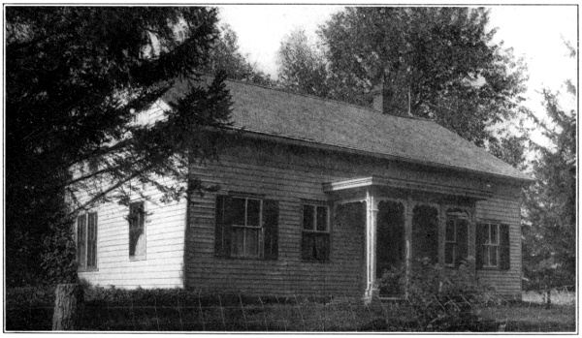
I Remember, I Remember…

Slide 21
What is Memory?
Memory refers to the mental processes that
enable the individual to
acquire
retain and
retrieve
information

Slide 22
Memory involves three basic processes
Encoding – the process of transforming information into a form that can be entered into and retained by the memory system
2. Storage – the process of retaining information in memory so that it can be accessed and used later
3. Retrieval – the process of recovering the stored information so that we are consciously aware of it

Slide 23
Human memory is not like…
or

Slide 24
How short is short-term, how long is long-term?

Slide 25
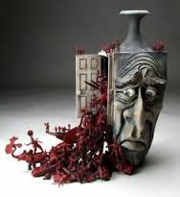
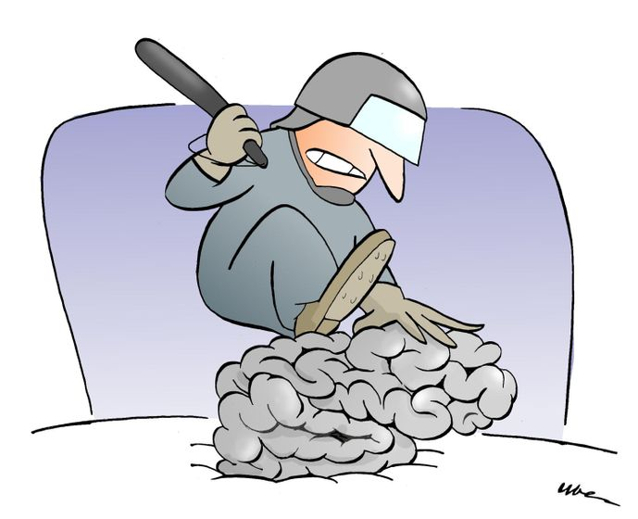
Long-term Memory
For the storage of information over extended periods of time
Has a limitless capacity
Retrieving information can be quick and easy, or it can be frustratingly impeded and complex.

Slide 26
Types of information in long-term memory
a. Semantic memory – (memory of meanings) - refers to general knowledge that includes facts, names, definitions, concepts, and ideas stored in long-term memory.
b. Procedural memory refers to the long-term memory of how to perform different skills, operations, and actions.
c. Episodic memory refers to your long-term memory of specific events or episodes in your life, including the time and place that they occurred.
Autobiographical memory refers to the events of your life—your personal life history.

Slide 27
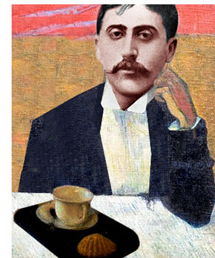
Accuracy?
“Remembrance of things past is not necessarily the remembrance of things as they were.”
Marcel Proust

Slide 28
Implicit and Explicit Memory: Two Dimensions of Long-Term Memory
a. Explicit memory is memory with awareness—information or knowledge that can be consciously recollected, including episodic and semantic memory
b. Implicit memory is memory without awareness—memories that cannot be consciously recollected, but that still affect behavior, knowledge, or performance of some task

Slide 29
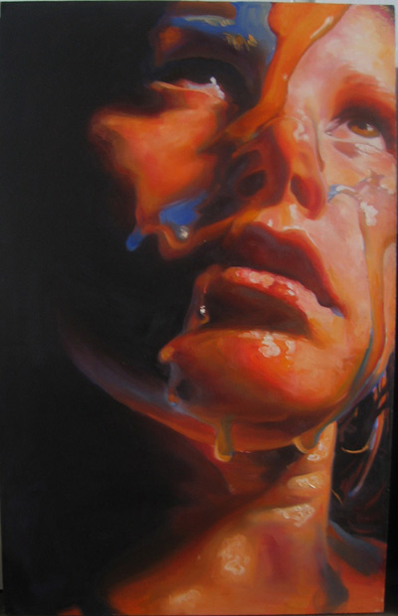
Impact of Child Sexual Abuse on Adults
CSA is a risk factor, but great care has to be taken regarding assumptions that it is the single causative factor – so the following are potential outcomes of CSA:
Post traumatic stress
Cognitive distortions
Emotional distress
Impaired sense of self
Avoidance
Interpersonal difficulties

Slide 30
Dissociation, denial and repression
Dissociation is an attempt to deal with an internal conflict that is triggered by an intolerable external situation. The person closes off part of what was previously conscious memory and feeling – a ‘selective forgetting’ without conscious intent – an ability to detach from adverse emotional states

Slide 31
Dissociation, denial and repression
Denial is the refusal to accept the factual situation or objective reality. It is quite a primitive psychological defence mechanism as it is characteristic of an earlier stage in personal development

Slide 32
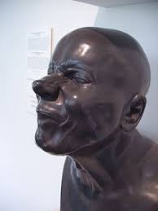
Dissociation, denial and repression
Repression, according to Freud’s theory, is the involuntary, concealment of uncomfortable thoughts and desires in the unconscious. People tend to repress memories when they are too painful or difficult to deal with at the time. People do not actively know that they are hiding their memories in their subconscious, that process is called suppression.

Slide 33
Representation of Freud’s theory of mind

Slide 34
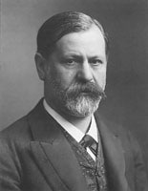
Freud lost his nerve
Sigmund Freud treated a number of women with symptoms of Hysteria - this condition included partial paralysis, hallucinations and nervousness.
Freud first mooted that the causes of hysteria were rooted in childhood sexual abuse.
But he later discarded this theory and proposed instead that it was childhood sexual fantasies that led to the development of a variety of neuroses and illnesses in adulthood – the Oedipal and Electra Complexes.

Slide 35
Undermining the credibility of women and children
By suggesting that complaints about being sexually abused were based on fantasy – on something imagined - Freud undermined the credibility of women and children, which were not strong anyway in the patriarchal society of his time.
It became easy to deny and explain away the experiences of people who had in fact been sexually abused as children. It was only in the final quarter of the 20th Century that Freud’s influence was mitigated and reversed.

Slide 36
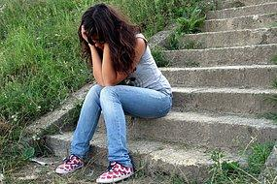
Not repression, but…
Repression is the rejection from
consciousness of painful or
disagreeable ideas, memories,
feelings or impulses. But many
women were not repressing
memories of childhood sexual
abuse; they were seeking a safe
place in which they could speak
about it and be believed

Slide 37
Pendulum swing in the 1980s

Slide 38
“Childhood sexual abuse explains so much…”

Slide 39
Ways of ‘recovering’ memory
Direct questioning
The symptom list
Imagistic work
Dream work
Journal writing
Body work
Hypnosis
Art Therapy
Feelings work
Group Therapy
Confrontations

Slide 40
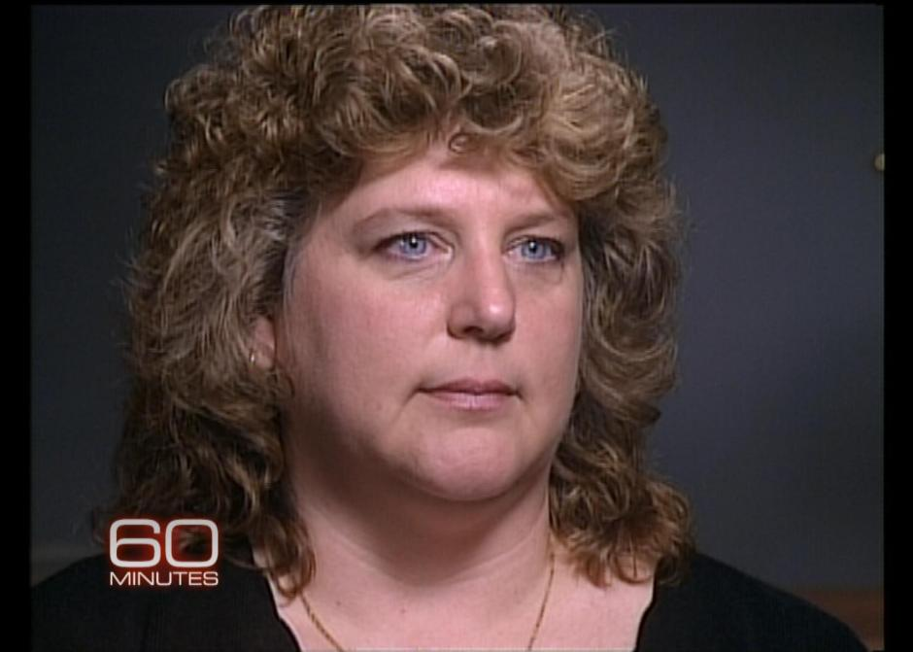
Implanted False Memory
In 1986, Nadean Cool, a nurse’s aid in Wisconsin, sought therapy from a psychiatrist to help her cope with her reaction to a traumatic event experienced by her daughter
Her psychiatrist used hypnosis and other suggestive techniques to uncover buried memories of abuse that Cool herself had experienced

Slide 41
Cool became convinced that she had repressed memories of
having been in a satanic cult
eating babies
being raped
having sex with animals
being forced to watch murder of her 8-year-old friend
Cool came to believe that she had more than 120 alter personalities

Slide 42
Outcome…
Cool eventually came to believe that false memories had been implanted
Cool sued psychiatrist for malpractice
in March, 1997, after 5 weeks of trial, her case was settled for $2.4 million

Slide 43
Two Camps
Recovered Memory
All memories recovered in therapy should be taken seriously
False memories are rare
If we raise doubts, we risk betraying children and supporting pedophiles
Pseudo-memory / False Memory
Memories recovered in therapy should be viewed with skepticism
False memories can be manufactured by naïve or unscrupulous therapists
There are many false accusations

Slide 44
Normal forgetting
Even if someone doesn’t remember a traumatic event, it’s not necessarily due to repression
Lack of memory for events that occurred before age 3 or 4 (infantile amnesia) is normal
Studies following up people who have experienced traumatic events found that 14% didn’t remember a motor vehicle accident and 25% didn’t remember being hospitalized one year later

Slide 45
Dr. Elizabeth Loftus
Loftus’s “shopping mall” studies
Asked subjects to try to remember childhood events that had been told to researchers by their parents, older siblings, or other close family members, of which…
3 events were real and 1 event (getting lost in a shopping mall at age 5) was false
29% “remembered” the false event
She demonstrated that false memories can be created

Slide 46
The course of events that Loftus finds worrisome
A therapist or a popular book
suggests that the patient
consider the possibility of
abuse
The patient engages in an intense effort to recall
An explicit episodic memory is achieved
This memory might be false,
With significant consequences

Slide 47
Guidelines on Memory and the Law British Psychological Society Research Board, June 2008
Memories are records of people’s experiences of events and are not a record of the events themselves
Memory is not only of experienced events but is also of the knowledge of a person’s life, i.e. schools, occupations, holidays, friends, homes, achievements, failures etc,
Remembering is a constructive process
Memories for experienced events are always incomplete
Memories typically contain only a few highly specific details

Slide 48
Guidelines on Memory and the Law British Psychological Society Research Board, June 2008
Recall of a single or several highly specific details does not guarantee that a memory is accurate or even that it actually occurred
The content of memories arises from an individual’s comprehension of an experience, both conscious and non-conscious
People can remember events that they have not in reality experienced

Slide 49
Guidelines on Memory and the Law British Psychological Society Research Board, June 2008
Memories for traumatic experiences, childhood events, interview and identification practices, memory in younger children and older adults and other vulnerable groups all have special features
A memory expert is a person who is recognised by the memory research community to be a memory researcher.

Slide 50
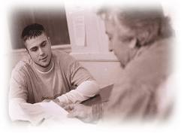
Responsible Therapy
We cannot know with certainty (without corroborating evidence) whether a ‘de-repressed’ memory is true;
Therefore –
Therapists should engage in probing this possibility very carefully, by…
avoiding suggestive questions
remaining open minded without corroborating evidence – a difficult call when the person needs to be believed
Encouraging the person to consider the possibility that the events didn’t happen, or may not have happened as they remember them

Slide 51
BREAK

Slide 52
Canonical Process
Fr. Michael Mullaney

Slide 53
Delicta Graviora ‘More Serious Crimes’
Overview of the Canon Law and Canonical Procedures in relation to sexual abuse of minors in the Catholic Church

Slide 54
Overview
Introduction – Legislation – Where it is at – Recent Developments
1. Notification of a Complaint
2. Referral and Decree Initiating a Preliminary Investigation
3. Restricted Ministry – “Stepping Aside” – Administrative Leave
4. The Preliminary Investigation
5. Reporting to CDF
6. Options of CDF
7. Judicial Penal Process
8. Administrative Penal Process
9. Direct Intervention of the Holy Father
10. Declaration, Authorisation, Confirmation of Disciplinary Non-Penal Measures
11. Canonical Process of Religious
12. Obligations of Bishop / Ordinary to clerics / religious who cannot be assigned or are dismissed

Slide 55
Canon Law in relation to Sexual Abuse and Reporting
Code of Canon Law (1983), Can. 1395 §2: A cleric who has offended in other ways against the sixth commandment of the Decalogue, it the crime was committed by force, or by threats, or in public or with a minor under sixteen years of age, is to be punished by a just penalty, not excluding dismissal from the clerical state if the case so warrants.
Apostolic Constitution Pastor Bonus (1988): art. 52: two types of crimes reserved to the Congregation for the Doctrine of the Faith
Crimes against the faith (delicta contra fidem)
More serious crimes (graviora delicta)

Slide 56
Canon Law in relation to Sexual Abuse and Reporting
Motu Proprio Sacramentorum sanctitatis tutela (30 April 2001)
Special particular law in which abuse -18 committed by a cleric was incorporated into graviora delicta
2003 Faculties obtained by Cardinal Ratzinger to provide greater flexibility in conducting penal process, including greater use of administrative processes, and in more serious cases, dismissal from the clerical state ex officio
2010 Prescription in case of abuse of minors is set at 20 years from moment of 18th year of victim – can be derogated in individual cases; child pornography is covered by can. 1395; venerable adults in such cases to be considered minors.

Slide 57
1. Notification of a Complaint
From the injured party
Third party (e.g. parent)
Statutory authorities
Media / social media
Offender
Anonymous

Slide 58
1. Notification of a Complaint
Semblance of truth
Imprecise? Vague? Lose? Subjective?
“Credible” allegation? – already implies guilt? Prima facie case?
It does not mean moral certitude or beyond reasonable doubt
Minimum threshold - excludes “absurd and improbable allegations that would not even require investigation in relation to its soundness or reliability”; “incomplete” allegations or allegations not criminally relevant
Papale 49
If it is not manifestly false or frivolous

Slide 59
1. Notification of a Complaint
Allegation must have some content / substance – contain the essential elements of the fact; nature of the acts, name of the accused, name of the injured party; when; where.
Categorised at this stage “hypothetical” and require verification which require proof in a canonical process which excludes inferences / conjecture.
In writing – as much detail as possible – signed.

Slide 60
2. Referral and Decree Initiating Preliminary Investigation
Statutory Authorities
All allegations even if frivolous or non-substantiated
National Safeguarding Office / Management Committee
CDF Circular Letter 2011 – “without prejudice to the sacramental internal forum (the seal of confession), the prescriptions of canon law regarding reporting of such crimes to the designated authority should always be followed. This collaboration, moreover, not only concerns cases of abuse committed by clerics, but also those cases which involve religions or lay persons who function in ecclesiastical structures.”

Slide 61
2. Referral and Decree Initiating Preliminary Investigation
Decree initiating a Preliminary Investigation
Prot. N. …. / ….
I the undersigned, AB, Bishop of the Diocese of CD, in light of the allegation disclosed by EF on the 31/12/14, of the offence outlined in can. 1395, §2, committed by Rev GH, a priest of this diocese; in accordance with can 1717, §1, the above mentioned allegation having the semblance of truth, with this decree appoint Rev/Mr/Ms IJ to carry out a preliminary investigation in to the above allegation, the circumstances and imputability; as well as KL as notary.
“The above mentioned are bound to carry out the investigation in a manner and confidentiality that respects the right of the accused to his / her good name. On the completion of the investigation, the acts of the investigation, including an evaluation of the facts, are to be returned to me in order to decide how best to proceed with the process.”
Signed / Dated / Etc

Slide 62
2. Referral and Decree Initiating Preliminary Investigation
This makes no determination on the guilt or innocence of the accused.
Canonical process / action is then suspended until completion of civil process.

Slide 63
3. Restricted Ministry / ‘Administrative Leave’ / ‘Stepping-Aside’
The changes to the law in 2010 authorise a bishop or the superior to impose restrictions on the ministry of the accused at the earliest stages of the proceedings: “17. The possibility of taking the cautionary measures foreseen in CIC can. 1722 … during the preliminary investigation is allowed (art. 19).”
Can. 1722 “To prevent scandals, to protect the freedom of witnesses, and to guard the course of justice, the ordinary, after having heard the promoter of justice and cited the accused, at any stage of the process can exclude the accused from the sacred ministry or from some office and ecclesiastical function, can impose or forbid residence in some place or territory, or even can prohibit public participation in the Most Holy Eucharist. Once the cause ceases, all these measures must be revoked; they also end by the law itself when the penal process ceases.”
Paramountcy-Principle: Legislator – universal and local – and the law must look to the common good. It requires that all have to acknowledge the rights of others in addition to their own. A careful examination of recent magisterium of the Church on the subject of sexual abuse of minors by clerics underlines the safety of children is a paramount concern for the Church and an integral part of its concept of the ‘common good’.

Slide 64
3. Restricted Ministry / ‘Administrative Leave’ / ‘Stepping-Aside’
The welfare of children and of the community must be the paramount criterion in decisions concerning a cleric’s continuing in parish / public ministry while being investigated for alleged sexual abuse of minors.
The best measure is a voluntary restriction of ministry with mutually agreed and signed document
Mutually agreed, discussed; less adversarial; maintains a good relationship between the Ordinary and the cleric; dignified and some sense of autonomy in a very traumatic situation
In the event that voluntary stepping aside from ministry is not possible, this measure can be imposed by means of a precept.

Slide 65
3. Restricted Ministry / ‘Administrative Leave’ / ‘Stepping-Aside’
What is a precept?
Canons 49-58; 1319
A precept is in the genre of an administrative decree / an administrative directive but has a negative character.
It provides for the concrete need of the community.
Through it the Ordinary orders a cleric / religious to do or not to do something
A precept is not an act of whimsy or caprice but an act to protect the common good

Slide 66
3. Restricted Ministry / ‘Administrative Leave’ / ‘Stepping-Aside’
A precept cannot be used as a penalty / permanent or it is an act of injustice and therefore not an act of good governance.
The imposition of a penalty requires the gathering of evidence
Due process
Right of defence
The person on whom the penalty is being issued for must be consulted and informed
Penalty can be imposed for not observing the precept
Must be in writing

Slide 67
3. Restricted Ministry / ‘Administrative Leave’ / ‘Stepping-Aside’
Penal Precept
Prot. N. …. / ….
I, Bishop AB, of the Diocese, having received (date) allegations of sexual abuse of a minor (can. 1395, §2) from CD against Fr EF, a priest of this diocese; for the common good of the community with this precept impose and order that in accordance with can. 1319, that Fr EF for the period of the civil and canonical process, under the penalty of interdict, does not: 1 – have unsupervised contact with minors;
2. have any contact with the accused or his / her relatives;
3 – reside in such a place and does not return to the parish of G; 4 does not celebrate publically the Eucharist or any other sacrament;
5 – any other restrictions deemed necessary – perhaps clerical dress (but can be perceived as punitive)
Signature of Bishop / Place / Date / Etc

Slide 68
3. Restricted Ministry / ‘Administrative Leave’ / ‘Stepping-Aside’
Precepts are precautionary
Priest continues to enjoy the presumption of Innocence
Bishop must provide / allow:
Appropriate Accommodation;
In some cases can remain in his house / parish
Income;
Clerical dress (unless clear and serious reason why not)

Slide 69
4. Preliminary Investigation
Preliminary Investigation is the responsibility of the Bishop / Ordinary
Only after the civil criminal process is complete
Conducted personally or through another suitably qualified person / delegate (lay/cleric), who has the same power/obligations as an “auditor” in a canonical process
The person conducting the preliminary investigation cannot act as a judge in the canonical process – if one is initiated later (can. 1717, §3)
The person chosen to conduct the preliminary investigation should be appointed by a decree unless the appointment has been contained in the decree opening the preliminary investigation

Slide 70
4. Preliminary Investigation
Purpose of a preliminary investigation:
Is there a case to answer;
Establish / verify the existence of a criminal act;
Imputability – is a person responsible for the act (normally presumed)
Gather the circumstances;
Get as complete a picture as possible;
Arrive at a sense of probability that the offence did or did not happen
To arrive at a justifiable reason to proceed

Slide 71
4. Preliminary Investigation
A preliminary investigation is not a trial
Administrative process
Should be completed in a brief period of time
Professionally conducted – not amateurish, hasty, casual, well presented and structured
Respectful of the rights of all parties – accused has a right to canonical advice if asked to participate in preliminary investigation
Confidential
The Ordinary evaluates whether to proceed or not
The one auditor / delegate gathers the material and forwards it to the bishop
Can if requested include his / her own evaluation
Bishop is free to consult with other judges / canon lawyers / others to evaluate
Delegate cannot be a judge
Closed by a decree

Slide 72
4. Preliminary Investigation
Preliminary Investigation – Closing Decree
Prot. N. … / …
I, the undersigned Bishop AB, Diocese, having received allegations of sexual abuse of a minor from CD by Fr EF on date; having initiated a preliminary investigation on date to be carried out by GH (date if necessary); having evaluated the material received from the delegate and having heard the advice of the following …., conclude that the allegations are founded / unfounded and that there is a case / no case to answer (for the reasons – if necessary / possible). I decree therefore to refer / not to refer the matter to CDF.

Slide 73
5. Reporting to CDF
Role of CDF:
Once the preliminary investigation has been completed and if it concludes that there is a case to answer, the Ordinary is to communicate the matter to CDF with his votum (opinion), irrespective of prescription (statute of limitations) reported or committed after 30 April 2001
CDF will direct the Ordinary how to proceed further:
Unless it calls the case to itself due to particular circumstances
Cases not to be referred to CDF
Manifestly false allegations / without foundation
Dead priests

Slide 74
5. Reporting to CDF
What to send to CDF?
Standard information
Personal Data and CV of Accused
Details of Allegations
Details of Civil Proceedings
Ancillary Information
Expert Advice / Risk Assessment
Notoriety of Accusations and Impact on the faithful
Details of current canonical status of accused including sustenance
Response of Accused
Votum of Ordinary – evaluation of allegations, whether there is a case to answer, future ministry, recommended process

Slide 75
5. Reporting to CDF
The CDF will appreciate as much information as possible on the preliminary investigation and the findings of local / national review boards (where carried out)
The Accused Priest and his Canonical Advocate are to make representations to the CDF as early as possible

Slide 76
6. Options of CDF
Authorisation of a Penal Process
Judicial Penal Process
In the diocese
In CDF
Administrative / Extra-Judicial Penal Process
Bishop / Ordinary with Two Assessors
Request for the direct intervention of the Holy Father
Declaration, Authorisation or Confirmation of Disciplinary Non-Penal measures

Slide 77
7. Judicial Penal Process
Must be authorised by CDF
Ordinary constitutes a tribunal of first instance
He appoints three judges
Documents of preliminary investigation given to the Promoter of Justice who prepares a libellus of accusation outing the allegation(s) to the presiding judge who determines whether to accept or reject the libellus by decree
Judge issues a decree of citation informing the accused of the allegations, inviting the accused to appoint an advocate allowing the accused / his advocate 10 days to have recourse to the judge
Judge to resolve objections expeditissime
Joiner of the Issues / Concordia dubii

Slide 78
7. Judicial Penal Process
Instruction of the Case
The Declarations of the Accused
Not bound to admit his crime
Judge has a right to interrogate him / evaluate refusal to testify
Documents
Statements to Gardai / police; medical, etc
Testimony of the Witnesses
Experts (if necessary) – psychological, hand-writing, IT

Slide 79
7. Judicial Penal Process
Publication and Inspection of Evidence
Promoter of Justice and Accused have a right to inspect evidence and make response
Judge may seek further clarification
Briefs of the Advocate and Promoter of Justice
Assessment of evidence and submissions of the Advocated and PI by Judge
Criterion of Moral Certainty
Sentence: short summary of the facts; the allegations; principles of law that apply in this case; arguments for and against; analysis of each allegation; conclusion for or against and in case of latter application of penalty
Appeal: heard at CDF or by judges appointed by CDF

Slide 80
8. Administrative / Extra-Judicial Penal Process
Administrative / Extra-Judicial Penal Process
The Ordinary or His Delegate:
Notifies the accused of the allegation and the proofs, and gives an opportunity for defence, unless the accused, having been lawfully summoned, has refused
Oral discussion with accused in the presence of the PI and a Notary
Bishop / Ordinary consults with two suitably qualified assessors
If the offence is certainly proven and a time for criminal proceedings has not elapsed, he issues a decree stating at least in summary from the reasons in law and in fact
A penalty short of dismissal can be imposed by Ordinary; if the Ordinary deems dismissal expedient the case to be returned to CDF

Slide 81
9. Direct Intervention of the Holy Father
Direct intervention by the Holy Father
Dismissio ex officio
Very grave cases where there has been a confession; custodial sentences have been imposed by civil courts
Dispensatio ab oneribus
Admission by priest who asks for dispensed from obligations of the clerical state

Slide 82
10. Declaration, Authorisation or Confirmation of Disciplinary Non-Penal measures
Declaration, Authorisation or Confirmation of Disciplinary Non-Penal measures
Usually involves limitation of or removal from ministry or ecclesiastical office
Removal of faculties
Declaration of impediment from exercising orders
Rights of Hierarchical recourse

Slide 83
11. Canonical Process / Investigation against a Religious
Relevant Canons: 695, §2, 696, 698-700
Step-by-step
The Provincial Superior (or equivalent) is to appoint a Canonical Investigator who will gather the evidence and proofs of the allegation(s). The Canonical Investigator must be a qualified canon lawyer familiar with the canonical principles contained in penal law (cc. 1321 ff) and canonical procedures.
Once the evidence/proofs have been gathered, the religious against whom a complaint(s) have been made has the right to present a defence. Therefore, the religious should be afforded the assistance of an Advocate, who must also be a qualified canon lawyer in order to ensure an adequate defence. The Advocate has the right to see all the evidence and proofs that have been gathered.

Slide 84
11. Canonical Process / Investigation against a Religious
The evidence / proofs / defence of the religious are then transmitted to the Provincial Superior who writes a votum / assessment of the allegations and evidence. All the material is then to be transmitted to the Supreme Moderator (or equivalent).
The Supreme Moderator evaluates the evidence, the arguments and the defense with the Council. The Council must be made up of at least four members. If the Council – after voting – finds the accused guilty and decides to dismiss the religious, a summary – for validity – of the reasons in law and in fact must be drawn up. Qualified canonical advice will be required for this.

Slide 85
11. Canonical Process / Investigation against a Religious
Any decree of dismissal must also be communicated to the Congregation for Religious with a copy of the acts of the case and the written summary outlining the reasons for the dismissal in law and in fact.
The dismissed religious has a right of recourse and during the time of appeal the decree of dismissal is suspended.

Slide 86
12. Concluding
If a priest is not dismissed, provision is to be made for his decent support when he cannot be given a ministry that would see to his sustenance (can. 1350, 1)
The Ordinary is also to provide for a dismissed cleric who is truly in need because of the effects of the penalty (can. 1350, 2)

Slide 87
LUNCH

Slide 88
Group Work
In groups discuss the following:
What has worked well for you using the NCMRG.
What more is needed from the NCMRG to assist with managing allegation and case management.
Have you any questions in relation to above.

Slide 89
Assessments
Teresa Devlin

Slide 90
Types of Assessments
Initial screening
Initial Assessment
Credibility Assessments
Risk Assessments
Psychological Assessments

Slide 91
Initial Screening
Standard 1:
All Church organisations must provide clear guidance on what to do when a concern arises.
Threshold: Reasonable grounds for concern
Report all allegations, concerns, suspicions
Record reasons for not reporting
Seek advice if unsure

Slide 92
Initial assessment
Clarity of initial allegation
Semblance of truth
Ministry with children
Risks to children of current ministry
Advice from civil authorities
Advice from NBSCCCI and/or NCMRG
Decision regarding ministry

Slide 93
Credibility assessment
Following completion of the civil inquiries the preliminary investigation is restarted.
Is there a case to answer?

Slide 94
Credibility
Gather evidence to support or negate the allegation:
Statement from complainant
Response from respondent
Third party information
Previous allegations/concerns
Corroboration of facts
Assessment of information
Report on findings

Slide 95
Tips for interviewing
Invest time and effort in Rapport Building
Be open minded at all times
Reflect back emotional state
If there is ‘difficulty’ in ‘believing’ any (outlandish) aspect of the account – be honest about this with the complainant/respondent (“what you have said happened is something that we don’t come across very often and seems very unusual to us”)
Be clear and honest about processes and roles at all times

Slide 96
Interviewing
Allow complainant to give a Free Narrative account before going for any detail - tell me in your own words what happened
Go for detail and test consistency over several accounts, revisit any inconsistencies openly but quite gently
If ‘displacement’ is suspected, be clear with the complainant that it is thought that something might have occurred but not in the way it has been told
Don’t ask the complainant to ‘explain’ the behaviour or motives of the alleged perpetrator no matter how tempting it might be to ask why do you think he did that?”
Be clear and honest about processes and roles at all times

Slide 97
Conclusion
Report drafted which sets out process, evidence, assessment and conclusion
Does the information gathered lead to a conclusion that there is a case to answer?
Seek advice : canon lawyer; NCMRG
If yes – submit to CDF

Slide 98
Risk Assessment
Precursor to safety plan
Credibility of allegation is agreed
Identifies areas of risk and how these should be managed

Slide 99
Risk Assessment
It is the collection, analysis and interpretation of the relevant available facts and information on a sex offender in order to understand, assess and classify his/her behaviour with regard to his/her current likelihood to commit a further sexual offence, and of potential danger should such offence occur.

Slide 100
Risk assessment - Internal
Credibility of allegation
Current contact with children
Current Ministry
Residence
Information sharing
Co-operation of respondent
Risk management plan

Slide 101
Risk Assessments/psychological
Carried out by qualified person
Uses a recognised model of assessment
Gives clarity on credibility of allegation
Provides information on likelihood of reoffending
Assists with risk management plan

Slide 102
Questions

Slide 103
Issues from the Floor
Colette Stevenson

Slide 104
Evaluations
And
Thanks

