Slide 1
Engaging Young People in Creating Safe Environments
Matthew Keown, Euan Lindsay and Niall Moore

Slide 2
Policy Statement
We recognise and uphold the dignity and fundamental rights of all children and are committed to ensuring their safety and well-being.
We value and encourage the participation of children and young people in the life of the Church to enhance their spiritual, physical, emotional, intellectual and social development.
We recognise that while the safeguarding of children is everyone’s
responsibility, all involved in working with children and young people have a special duty of care towards them.

Slide 3
Article 12
1. States Parties shall assure to the child who is capable of forming his or her own views the right to express those views freely in all matters affecting the child, the views of the child being given due weight in accordance with the age and maturity of the child.
2. For this purpose, the child shall in particular be provided the opportunity to be heard in any judicial and administrative proceedings affecting the child, either directly, or through a representative or an appropriate body, in a manner consistent with the procedural rules of national law.

Slide 4
Article 12
Space
Voice
Audience
Influence

Slide 5
Matthew Keown

Slide 6
What is this Standard?
Children have a right to an environment which is free from abuse and neglect; they should have access to good role models whom they can trust, who will respect, protect and nurture their spiritual, physical and emotional development.
Church organisations must develop a culture of safety that welcomes children and contributes to the well-being and empowerment of children. Creating and maintaining safe environments reduces the risk of children being harmed in any way by those designated by the Church to care for them.

Slide 7
Euan Lindsay

Slide 8
Action Camps

Slide 9
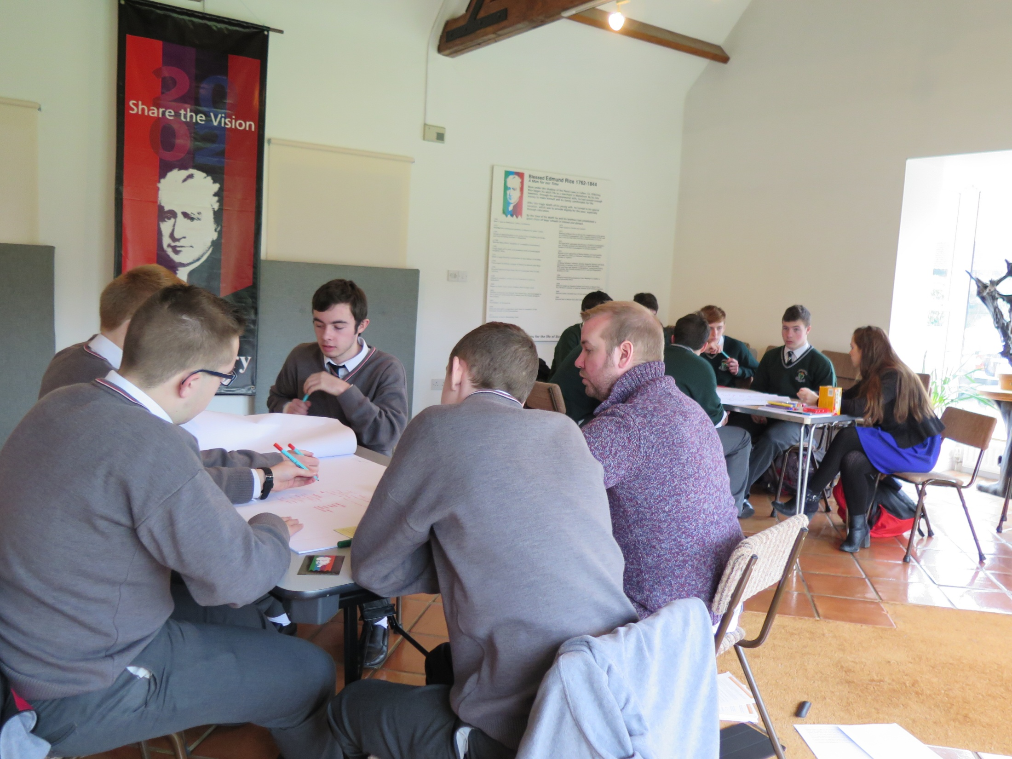
Workshop on Child Safeguarding Standards

Slide 10
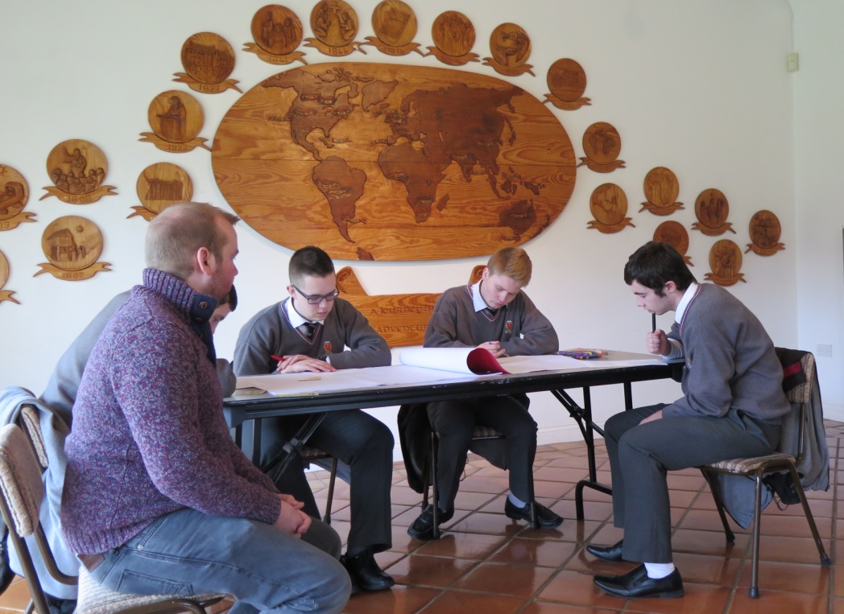
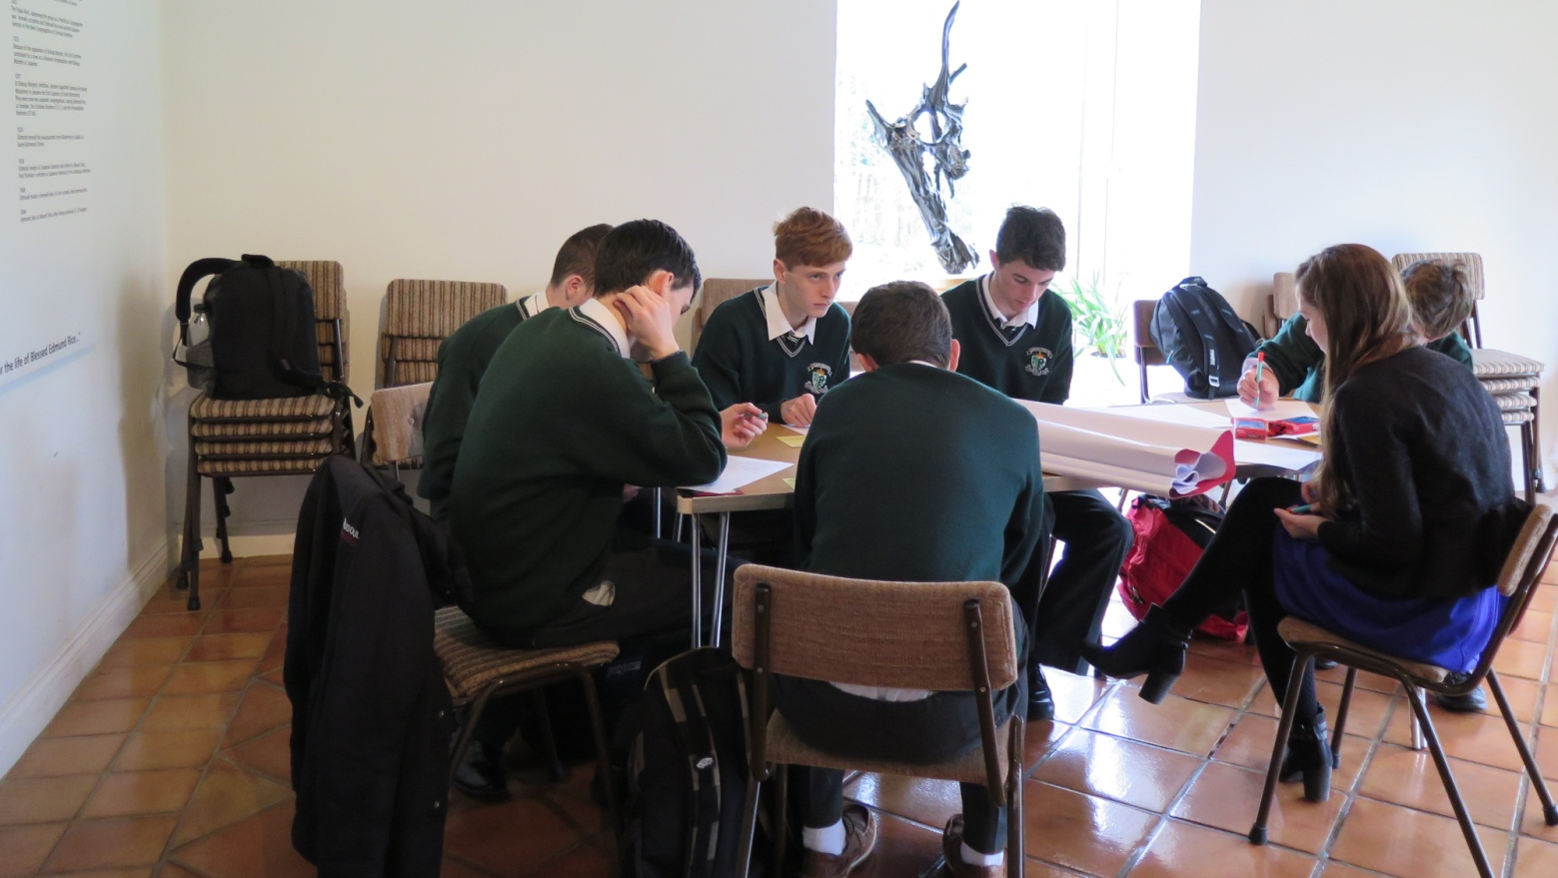

Slide 11
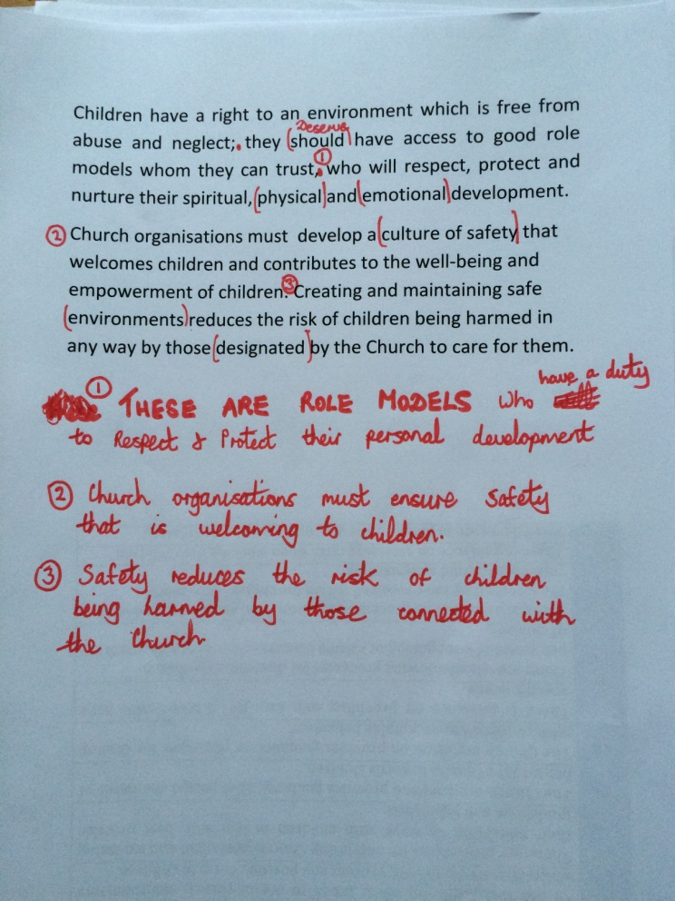
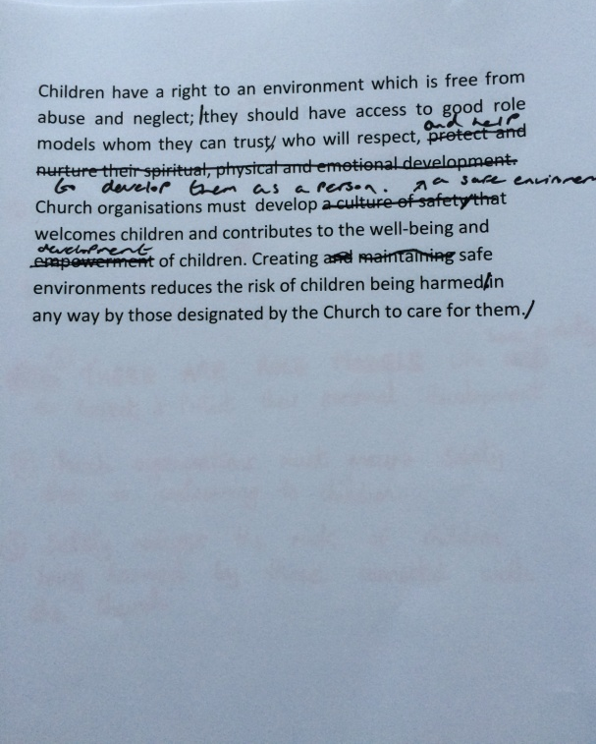
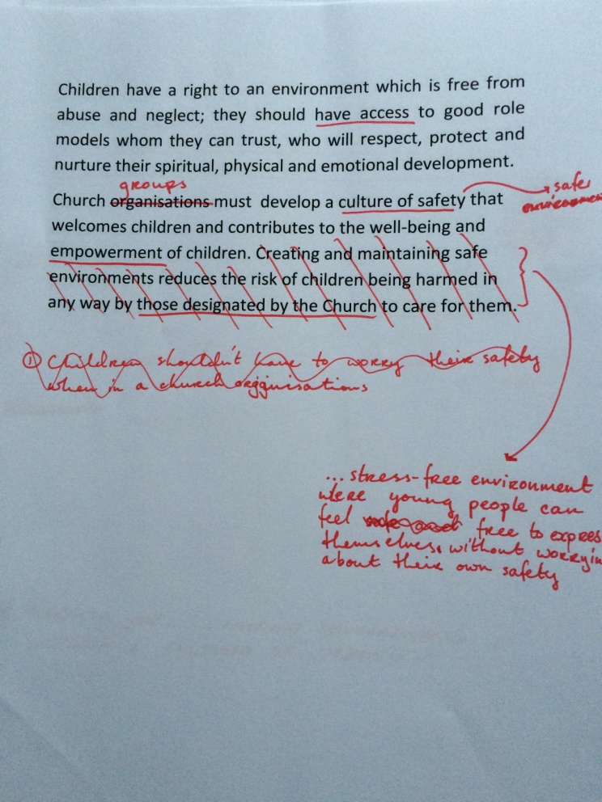

Slide 12
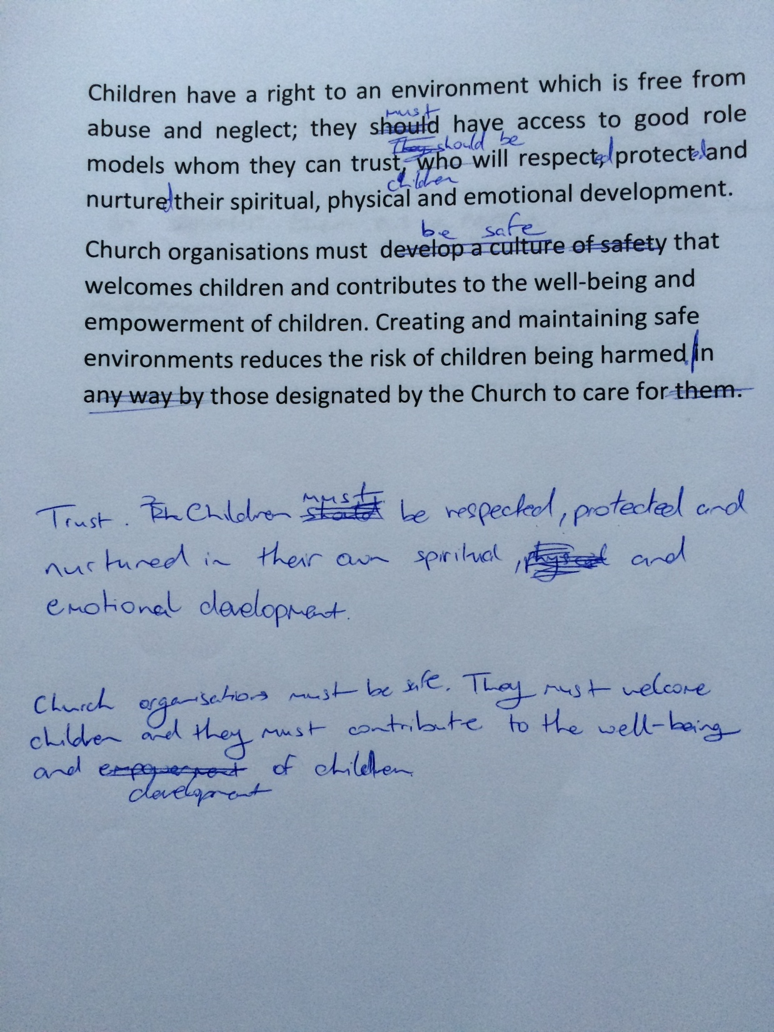
Children have a right to an environment which is free from abuse and neglect.
They must have access to good role models whom they can trust.
Children must be respected, protected and nurtured in their development.

Slide 13
Church organisations must be safe. They must welcome children and they must contribute to the well being and development of children. Creating and maintaining safe environment reduces the risk of children being harmed.

Slide 14
Children's Liturgy Group

Slide 15
7 Simple Rules...
Location
2. Diversity of leaders
3. Establishing rules
7. Dealing with parents and complaints
4. Special needs
5. Risk Management
6. Money
The environment needs to be safe... and fun!

Slide 16
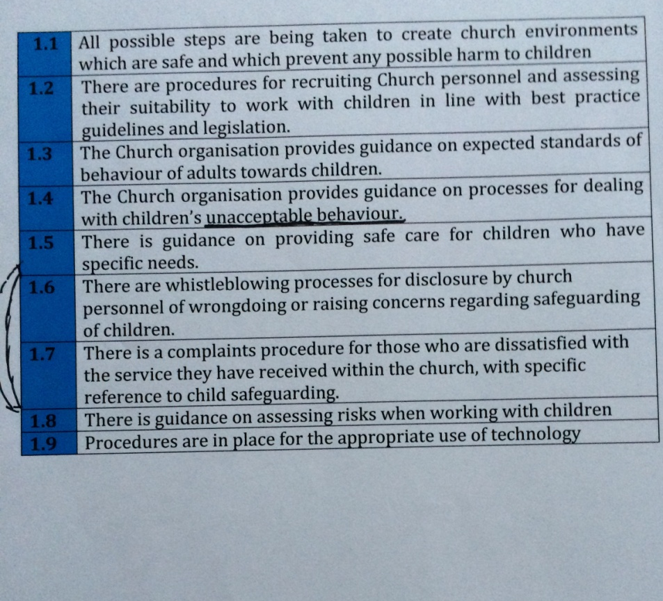
The Indicators

Slide 17
