Slide 1
Training for Lay Apostolates
27th March 2019

Slide 2
Welcome, Introductions and Prayer
Teresa Devlin

Slide 3
Aims for the Day
Familiarise participants with the requirements of the Church's safeguarding children policy and standards
Update participants on the legislative developments in relation to safeguarding children
Outline the audit and governance requirements in relation to safeguarding children
Outline proposals to formalise the relationship between lay apostolates and the NBSCCCI.

Slide 4
Questionnaire

Slide 5
Lay Apostolates Guidance

Slide 6
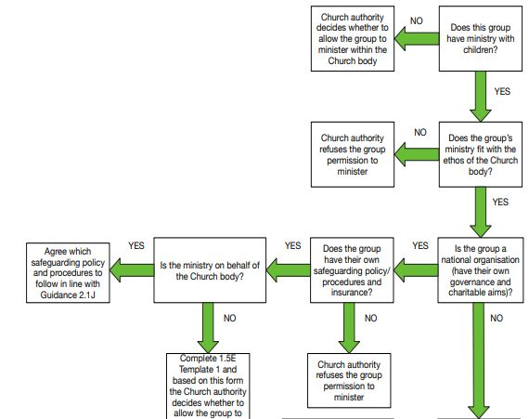
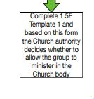

Slide 7
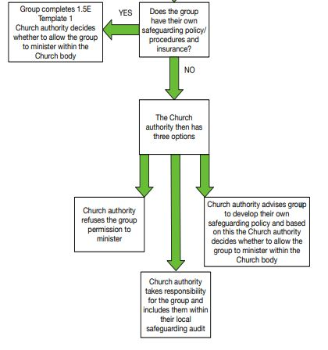

Slide 8
National Lay Apostolates
Have their own policy procedures and governance arrangements
Sign external group form if you using Church property
Agree which procedure you are following when ministering on behalf of the Church body

Slide 9
Local Lay Apostolates –with your own procedures
If you have your own policy and procedure group completes 1.5E Template 1 for the Church authority
Sign external groups form if using Church property

Slide 10
Local Lay Apostolates –without your own procedures
Either Church authority refuses you permission to minister
Church authority takes responsibility for the group
You develop your own procedures

Slide 11
Key questions
Have you permission to minister from the Church authority?
Do you have appropriate insurance?
Whose policy do you follow and when?

Slide 12
Terminology, Website and App
Terminology used throughout this presentation and where it can be found in the Policy and Standards document
Policy is pages 8-12
Policy Statement is the first two paragraphs of page 8. The wording of these paragraphs cannot be changed or adapted in any way.
Standards are set out on page 13
Indicators are the standards broken down and are grouped into 3 categories:
  Ministry with children (Table 1) page 16
  Those with no ministry with children but are managing cases (Table 2) page 18
  Those with no ministry with children (Table 3) page 20
Procedures are the written documents you need to help assist with practice to live out the indicators of the standards. The guidance can help you to do this, if you need it.
Guidance is support for all aspects of safeguarding children and is there to assist if necessary

Slide 13
Ministry with Children
Any work or service undertaken by Church Personnel with children, which is under the authority of their church body
Any work with children undertaken by Church personnel (lay, vowed and ordained) within Church property, which is under their authority of their Church body;
All priests in active ministry under the authority of their Church body are to be considered as having ministry with children.

Slide 14


Slide 15
Break

Slide 16
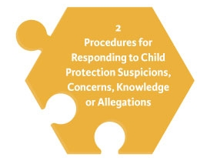
Standard 2: Procedures for Responding to Child Protection Suspicions, Concerns, Knowledge or Allegations.
Clear guidance to ensure a prompt response to allegations, suspicions, and concerns about a child’s safety or welfare
All concerns are reported promptly to the statutory authorities
Guiding principle: Safety of the child is the paramount consideration

Slide 18
Mandated Persons
Mandated persons (as defined in the Children First Act 2015) are people who have contact with children and/or families and who, because of their qualifications, training and/or employment role, are in a key position to help protect children from harm
Each Church body should consult the full list of categories who are classified as mandated persons under Schedule 2 of the Children First Act 2015 to establish which members of Church personnel are classified as mandated persons

Slide 19
Mandated Persons
It should be understood that:
All clerics and religious are to be considered mandated persons
Volunteers are not mandated persons under the Children First Act 2015. However DLPs or Deputy DLPs who are volunteers are classed as mandated persons under Church standards.

Slide 20
Mandated Persons
On completion of this process the Church authority must retain a list of all mandated persons, and ensure this is kept up to date. In developing this list Tusla have advised that there should be a clear statement of the type of roles that a Church body are listing as mandated persons then a number of mandated persons that are in the Church body against each role. For Example
  Clerics (25),
  Pastoral Workers (50),
  Religious (15) etc).
For more information see Guidance 2.1L

Slide 21
Lunch

Slide 22
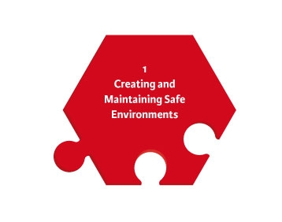
Standard 1: Creating and Maintaining
Safe Environments
Church bodies provide an environment for children that is welcoming, nurturing and safe. This may include:
Safe recruitment and vetting practices.
Appropriate codes of behaviour for adults/children.
Safe environments and activities for all children.
Safe use of Church property by external groups.
Whistleblowing and complaints
Hazard assessment
Safe use of IT
Ensuring priests/religious who minister in external organisations understand their child safeguarding responsibilities

Slide 23
Key questions
Are these procedures in place?
Safe recruitment and vetting
Insurance?
Trips away from home?

Slide 24
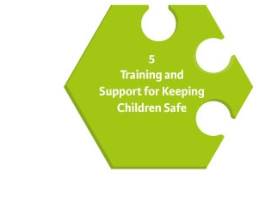
Standard 5: Training and Support for Keeping Children Safe
Relevant training is available for all involved in any way with children to develop and maintain the necessary attitudes, skills and knowledge to keep children safe
To carry out this role confidently and effectively, they need to be aware of child protection issues
Everyone has a role to play in child protection and safeguarding

Slide 25
Key questions
Training required:
  All mandated persons need to be trained in their role
  For those who have ministry with children at least one of leaders require a full day training every 3 years, others can attend an information session
  All who have a role in safeguarding require a full day training every 3 years
  All priest and religious require a full day training every 3 years
  Everyone else needs to be given an opportunity to attend an information session

Slide 26
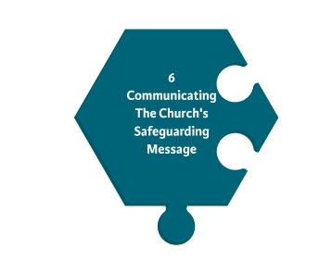
Standard 6: Communicating the
Church’s Safeguarding Message
Ensuring that the Church body makes information on safeguarding children available to all

Slide 27
Child Safeguarding Statement
POINTS TO CONSIDER
This only applies if you have ministry with children and are in the Republic of Ireland.
It is a requirement of Tusla and the Children First Act 2015, it does not replace our existing policy

Slide 28
Child Safeguarding Statement
WHAT I HAVE TO DO
Appoint a Relevant person- these are contact people for any questions regarding the Child Safeguarding Statement
Produce the Statement- we have written one for the whole Church which you can adapt it’s available here https://www.safeguarding.ie/images/Pdfs/StandardsDocs/6.2D%20Template%201%20Example%20Child%20Safeguarding%20Statement.doc
Make it available on your website and email it to all Church personnel by the 1 11th of March 2018- this is a requirement of the Children First Guidance.

Slide 29
Key questions
How do you communicate the message?
Do you need a safeguarding statement?

Slide 30
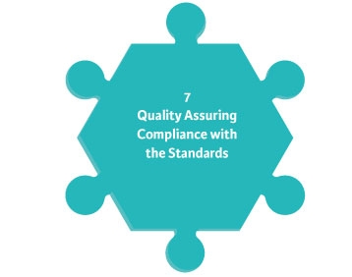
Standard 7: Quality Assuring
Compliance with the Standards
Each Church body develops a plan of action to quality assure compliance with the standards, which is reviewed annually.

Slide 31
Ensuring Compliance-Procedure
Niall

Slide 32
Indicator 7.1
The Church authority:
Puts in place arrangements to ensure and evaluate its compliance with the safeguarding Standards at a local level;
Produces a report on the level of compliance established through this audit exercise
Notifies the National Board in writing of this annual audit report

Slide 33
Bullet Point 1
Compliance at a local level is achieved through the following:
Ensuring that a local safeguarding audit is completed depending on your level of ministry with children and a report of the findings produced. (7.1C Templates1,2 or 3)
If you have cases, ensuring that a report is completed of all active cases by your DLP (7.1D Template 1)
If appropriate conducting monitoring visits (7.1B)
Having a clear induction process for new leadership or staff (7.1E)

Slide 34
Bullet Point 2
Producing Reports

Slide 35
Bullet Point 3
Once the report from DLP and report from Safeguarding Committee are received the Church Authority writes to the National Board to say that the local audit is completed and plans to address any gaps are in place.
Template letters for those that are in Table 1 or 2 of the policy – 7.1C Template 4
Template letter for those that are in Table 3 of the policy - 7.1C Template 5

Slide 36
Indicator 7.2 (Ignore if you have no ministry or cases)
The Church body produces a three year safeguarding plan
Guidance for this is contained in 7.2A Template 1
The plan should outline the actions identified from the local safeguarding audit and how these should be addressed

Slide 37
Relationship with NBSCCCI- Proposals
Written resolution with NBSCCCI being completed in June
Annual audit and inform us
Review?

Slide 38
Questions and Evaluation

