Slide 1
Training for Support People
22nd April 2015

Slide 2
Welcome
Colette Stevenson

Slide 3
Prayer
Jane Ferguson

Slide 4
Aims for the Day
To identify and discuss your understanding of the role and what excites and challenges you.
To identify what we expect the Support Person to do
To give you practical experience and advice on how to carry out the role

Slide 5
Key Times
Break 11:45
Lunch 13:00
End 15:00

Slide 6
Your Role

Slide 7
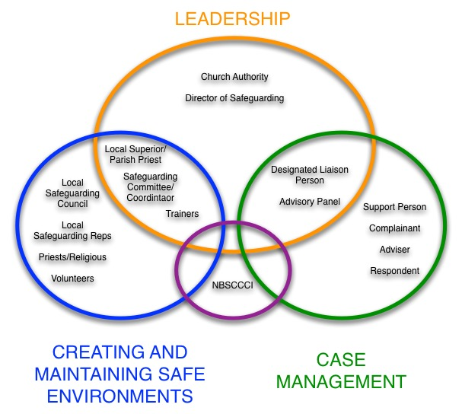

Slide 8
Your Role
Your role is:
Keeping the complainant informed of the process of the case.
Helping direct the complainant to counselling and support.
Recording any meetings or contact they have with the complainant, and reporting to DLP as appropriate.
Upholding the 7 standards in practice and behaviour.

Slide 9
Your Role
Your role i’snt:
To be a counselor
To be a spiritual director
To be the case manager

Slide 10
The 7 Standards

Slide 11
What is expected: The Seven Standards
A written policy for keeping children safe.
Written procedures for responding to allegations, suspicions and concerns.
Policies and practices to prevent harm to children.
Training and education for safeguarding personnel.
Clear processes to communicate the Church’s child safeguarding policy and procedures.
Access to advice and support for victims and perpetrators.
A plan to implement and monitor policies and procedures.

Slide 12
The 7 Standards
Standard 2
A written procedure for responding to allegations
Standard 1
A written policy
For keeping children safe
Standard 3
Policies and practices to prevent harm to children
Standard 7
A plan to implement and monitor the standards
Standard 6
Access to advice and support
Standard 4
Training and education for safeguarding personnel
Standard 5
Communicating the Church’s safeguarding messages

Slide 13
Creating and Maintaining
Safe Environments
Communicating
The Church’s Safeguarding
Message
Procedures for Responding to Child Protection
Allegations, Concerns and Suspicions
Implementing and Monitoring the Standards
Care and Support for the
Complainant
Training and
Support for Keeping
Children Safe
Care and Management
of the
Respondent

Slide 14
Care and Support for the Complainant
3.1 The Church Authority has personnel in place – lay or religious – whose clearly defined roles are to liaise with the person who alleges abuse (the complainant), or their nominated representatives.
3.2 The Church Authority has developed working relationships with the statutory child protection agencies and relevant voluntary organisations within which information, support and assistance is made available to the complainant, and to Church personnel as required. Church personnel seek specialist advice from the statutory child protection services when necessary, e.g. when the complainant is a child.
3.3 The Church Authority offers appropriate pastoral care and support to people who have been abused by Church personnel, which recognises their unique needs.

Slide 15
Links to Other Standards
Standard 2 and 4
Clearly understand the case management process and the role of the support person within that
Standard 7
The importance of keeping records up to date, to enable the DLP to produce an internal report on standard 2, 4 and 7 for the Church Authority

Slide 16
Why do we safeguard?

Slide 17
Why do we safeguard?
The Law
The United Nations Convention on the Rights of the Child (1989)- recognises children as people with holders of 42 rights which must be respected by the laws of individual countries including the Holy See, Ireland and the United Kingdom.
All of the laws which are discussed later are a part of upholding the rights of children and young people.

Slide 18
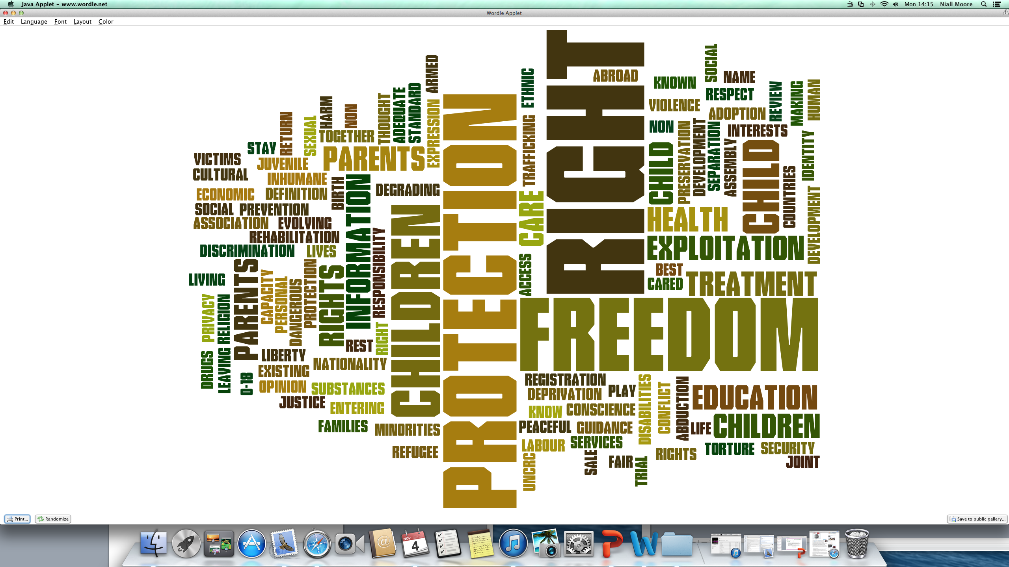

Slide 19
Why do we safeguard?
Key messages from the past
Today the welfare of children is of paramount importance, in the past this wasn’t always the case.
Church-based organisations must be responsible for safeguarding in its widest sense (to ensure safe environments and safe practices for young people) as well as ensuring adequate responses to any apparent or reported concerns.

Slide 20
Why do we safeguard?
The Gospel
Safeguarding children is a practical living out of the baptismal vocation of every member of the Church to ensure the safety and well-being of those ‘little ones’ whom the Lord sets before us as those to whom the ‘kingdom of God belongs’.
(Mt 19:14)

Slide 21
Towards a Theology of Safeguarding
Jane Ferguson

Slide 22
BREAK

Slide 23
Keeping the Complainant Informed

Slide 24
Keeping the Complainant Informed
It is part of your role to keep the complainant
up to date with the process of their case and provide
them with appropriate support or counseling.
To do this you need to understand the process of
case management which you can attend training on.
But you should also be kept informed of the case by
the DLP through regular meetings.

Slide 25
Keeping the Complainant Informed
During your meetings with complainant they may
require support:
If it’s about counselling refer to Towards Healing
It it’s about spiritual help refer to Toward Peace
If it’s about anything else speak to the DLP
Its important you document and record these
requests and pass to the DLP to put in the case file
Refer to Handout

Slide 26
Practical Experience of Being a Support Person
Jane Ferguson
Liam Lally

Slide 27
LUNCH

Slide 28
Support
Colette Stevenson
Una Allen

Slide 29
Who needs support?
Complainant
Respondent
Congregation
Safeguarding Personnel

Slide 30
What kind of support?
Complainant- Towards Healing, Toward Peace, Support Person
Respondent- Counselling, Adviser
Congregation- Counselling
Safeguarding Personnel - Supervision

Slide 31
What is Supervision?

Slide 32
A definition for the Church
An arrangement to discuss your work regularly with another person formally and informally
Supervision is designed for you to work together to ensure and develop the efficacy of working situations
It will gather the actions and behaviours and feelings about the work, together with the supervisor’s reactions, comments and challenges
It is a practice that is bounded by an explicit contract that emphasises that the needs of the person being ministered to take priority.
It is NOT therapy

Slide 33
How does the Process work?
1. Initially a person is chosen who:
You believe you can relate to
You believe you can trust and
Has the right skills for what you need
2. A contract or written agreement is produced which covers:
Costs
Frequency of supervision
Meeting place
Confidentiality

Slide 34
How does the Process work?
3. At The Session
Supervisee submits relevant issues that emerged in their work especially issues that were difficult to deal with
Supervisor encourages them to look at other possible ways of responding
What was happening to supervisee as they worked?
What was the relationship like?
Targets are set for the next session
4. Periodic Review
Set milestones are agreed when the supervision process will be evaluated

Slide 35
Challenges
How is it resourced?
How is confidentiality maintained?
Difficulty in trust
How are objectives set and achieved?
How do you convert what is said in supervision to actions?

Slide 36
Recording Meetings

Slide 37
Scenarios

Slide 38
What to Record
During your meetings with complainant a number of
Issues may come up, you should record:
Dates times and locations of meetings
Any requests for support
Any additional information with regards the case
Refer to Handout

Slide 39
Questions and Evaluation

