Slide 1
Training for DLPs
7th March 2018

Slide 2
Welcome, Introductions and Prayer
Teresa Devlin

Slide 3
Aims for the Day
To discuss current challenges facing DLPs
To update you with regards recent legislative developments in ROI
To revisit the canonical processes and highlight new guidance in relation to new challenges
To discuss assessing risks with regards return to ministry

Slide 4
What challenges do you face?

Slide 5
New Changes Following Children First 2015
Niall Moore

Slide 6
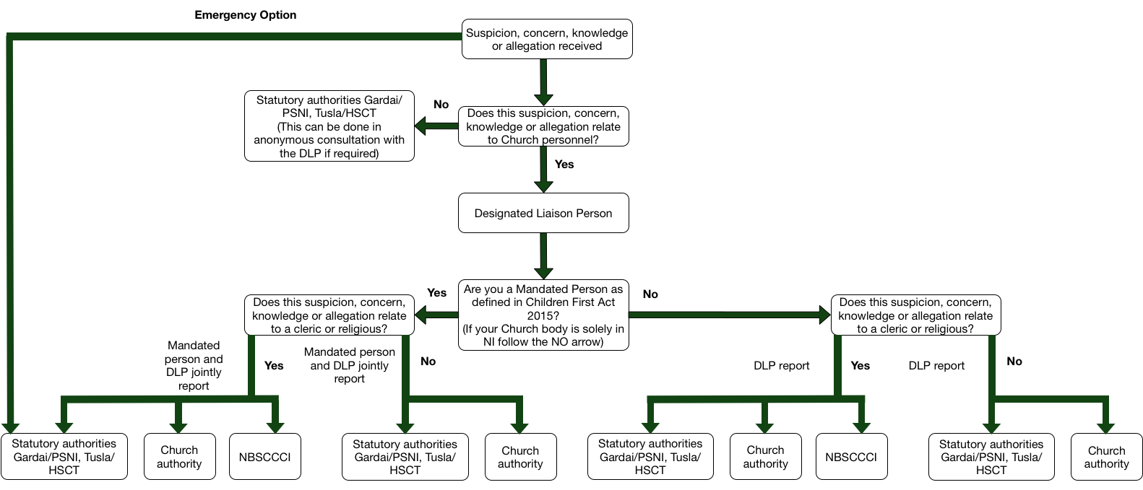

Slide 7
Reporting Forms
Two new forms from Tusla:
One for retrospective allegations (those when the complainant was a child but is now an adult)
One for current allegations (those when the complainant is a child)
The gardai will accept the forms from Tusla
The NBSCCCI form has remained the same, but now contains a joint signature space for mandated persons

Slide 8
Mandated Persons
Mandated persons (as defined in the Children First Act 2015) are people who have contact with children and/or families and who, because of their qualifications, training and/or employment role, are in a key position to help protect children from harm
Each Church body should consult the full list of categories who are classified as mandated persons under Schedule 2 of the Children First Act 2015 to establish which members of Church personnel are classified as mandated persons

Slide 9
Mandated Persons
It should be understood that:
All clerics and religious who have any ministry are to be considered mandated persons
Volunteers are not mandated persons under the Children First Act 2015. However DLPs or Deputy DLPs who are volunteers are classed as mandated persons under Church standards.

Slide 10
Mandated Persons
On completion of this process the Church authority must retain a list of all mandated persons, and ensure this is kept up to date.
In developing this list Tusla have advised that there should be a clear statement of the type of roles that a Church body are listing as mandated persons then a number of mandated persons that are in the Church body against each roles.
For Example
Name and contact details of DLP
Clerics (25),
Pastoral Workers (50),
Religious (15) etc).
For more information see Guidance 2.1L

Slide 11
Reporting Scenarios
For each scenario answer:
Who would this be reported to?
Is the person receiving the allegation a mandated person?
Which forms should be used?

Slide 12
Child Safeguarding Statement
POINTS TO CONSIDER
This only applies if you have ministry with children and are in the Republic of Ireland.
It is a requirement of Tusla and the Children First Act 2015, it does not replace our existing policy

Slide 13
Child Safeguarding Statement
WHAT I HAVE TO DO
Appoint a Relevant person- these are contact people for any questions regarding the Child Safeguarding Statement
Produce the Statement- we have written one for the whole Church which you can adapt it’s available here https://www.safeguarding.ie/images/Pdfs/StandardsDocs/6.2D%20Template%201%20Example%20Child%20Safeguarding%20Statement.doc
Make it available on your website and email it to all Church personnel by the 1 11th of March 2018- this is a requirement of the Children First Guidance.

Slide 14
Break

Slide 15
Preliminary Investigations and
Collecting the Proofs

Slide 16
Preliminary Investigation/Collecting the Proofs
These are canonical terms that refer to the initial investigation by which a Church authority determines whether an allegation of child abuse, which has reached the threshold of a semblance of truth, is not manifestly false or frivolous and there remains a case to answer.
There are two different canons that govern them 1717 and 695.
We will use the term Preliminary Investigation to talk about both processes

Slide 17
Semblance of Truth
Evidence that, at face value, corroborates the notification. The certitude being sought is “much less than probable and even less than certain. In the end the Church authority is looking to see if the notification contains facts, circumstances, and imputability which are even remotely possible.
When this semblance of truth is gained, no matter how low a certitude it might contain, it carries a certain level of moral and juridic responsibility which impinges on the Church authority to initiate a preliminary investigation.

Slide 18
Ordinary
Canon 134 - in law the term Ordinary means, Church authority (excluding the Pope) including
Bishops, and all who, even for a time, are set over a particular Church or community
equivalent to it in accordance with Canon 368.
We use the term Church authority

Slide 19
Delegated Person
The person appointed by the Church authority to carry out the preliminary investigation/collecting the proofs and various parts of the canonical process where an allegation of abuse has been made about a cleric/religious.

Slide 20
Votum
An authoritative opinion. In forwarding a case to the relevant congregation in Rome, a member of the Church authority offers their authoritative opinion on the matter addressed in the particular case.

Slide 21
Decree
A singular decree is an administrative act issued by a Church authority, in which a decision is given or a provision is made under a case according to the norms of law

Slide 22
Precept
A singular precept is a decree that directly and legitimately enjoins a specific person or persons to do or omit something, especially in order to urge the observance of law.

Slide 23
Indicator 4.3

Slide 24
Guidance that will be helpful
4.3A: Guidance on the Process for Clerics Following the Conclusion of Any Investigation by the Statutory Authorities
4.3D: Guidance on the Process for Non-Ordained Religious, Following the Conclusion of Any Investigation by the Statutory Authorities
All can be accessed at this link https://www.safeguarding.ie/images/Pdfs/Standards/Standard%204.pdf

Slide 25
For Clerics
Can. 1717 § 1 Whenever the Ordinary receives information, which has at least the semblance of truth, about an offence, he is to enquire carefully, either personally or through some suitable person, about the facts and circumstances, and about the imputability of the offence, unless this enquiry would appear to be entirely superfluous.
§2 Care is to be taken that this investigation does not call into question anyone's good name.
§ 3 The one who performs this investigation has the same powers and obligations as an auditor in a process. If, later, a judicial process is initiated, this person may not take part in it as a judge.

Slide 26
One Canon – but Complex
Purpose – The preliminary investigation does not determine someone’s guilt, instead it merely assists the Ordinary in making a judgement about whether this information should give birth to a full penal process in which a formal accusation is made.
It’s a Procedure - an executive administrative process – not a canonical process

Slide 27
For Non Ordained Religious
Can. 695 § 1 A member must be dismissed for the offences mentioned in canon. 1397, 1398 and 1395, unless, for the offences mentioned in can. 1395 § 2, the Superior judges that dismissal is not absolutely necessary; and that sufficient provision can be made in some other way for the amendment of the member, the restoration of justice and the reparation of scandal.
§ 2 In these cases the major Superior is to collect the evidence concerning the facts and the imputability of the offence. The accusation and the evidence are then to be presented to the member, who shall be given the opportunity for defence. All the acts, signed by the major Superior and the notary, are to be forwarded, together with the written and signed replies of the member, to the supreme Moderator.

Slide 28
No need to seek authorisation from any other authority.
The respondent is to have the accusation put to him with the proofs gathered to sustain it and be given a right of defence.
The Church authority, once they have all the material gathered must present them to his council.

Slide 29
The First Decision- A semblance of Truth
The allegation, suspicion, concern or knowledge may come in a variety of forms but if it reaches the threshold it is passed to the Statutory authorities, the NBSCCCI and the Church authority.
Generally, if it meets the threshold for reporting to the statutory authorities it has automatically fulfilled the requirement of ‘a semblance of truth’. However there are exceptions.
If it fails to meet the threshold for reporting to the statutory authorities the Church authority must assess whether a semblance of truth is present.
Once the semblance of truth has been reached Canon 1717 §
requires the Church authority to conduct a further inquiry

Slide 30
Semblance of truth present
Church authority initiates the preliminary Investigation by a decree:
indicating the date the complaint was received,
the name of the cleric accused,
the object of the investigation, i.e. a violation of article 4 of the norms of Sacramentorum sanctitatis tutela (SST)
the provisions of universal law under which the investigation is committed.
Appoints the delegated person(that’s you)
Pauses the process until the statutory authorities have given the go ahead to proceed.

Slide 31
Scenarios
For each scenario:
Consider whether the semblance of truth is present in each case

Slide 32
Knowing When to Stop
When? When the delegated person believes they have gathered enough information to enable the Church authority to make a determination.
The level of certitude being sought is greater than a mere “semblance of truth”, but it is less than “moral certitude” which is required (is there a case to answer)

Slide 33
The Next Part of the Process
When? When the delegated person believes they have gathered enough information to enable the Church authority to make a determination.
The level of certitude being sought is greater than a mere “semblance of truth”, but it is less than “moral certitude” which is required (is there a case to answer)
The Delegated Person much compile a report with their findings, including all the testimony and acts of the preliminary investigation.
The Church authority issues a decree closing the Preliminary Investigation.
The Church authority may review report with his review board or the National Case Management Committee.

Slide 34
New Guidance
6 new draft decrees to help make this process clearer.
It should be understood that each decree must be unique to the case.
Whether you want the delegated persons opinion or just the facts that they have gathered, must be stated in the decree.

Slide 35
Current Challenges in Case Management
Character witnesses (new guidance issued)
GDPR and information sharing
Dealing with uncomfortable practices
Boundary violations (new guidance in process)

Slide 36
Lunch

Slide 37
Management of Allegations- Zero Tolerance or Redemption
Teresa Devlin

Slide 38
Notification of all allegations
Consider Restrictions on Ministry
Seek advice – Advisory Panel/NCMC
Conclusion of statutory investigations
Preliminary investigation
Interim Management plan/Permanent Management Plan

Slide 39
Considerations on Restrictions to Ministry
What information do you have?
What is the current ministry of the respondent?
What are the risks?

Slide 40
Case Examples
An allegation has been received against Brother John through Towards Healing. The information states that Gerard Green alleges he was sexually abused by Brother John in 1984 when Gerard was 12. There are no more details.
What are the issues that you should consider?
Should Brother John’s Ministry be restricted?

Slide 41
Scenario 1
Father John has been out of ministry for 5 years. As the new Bishop you have been asked by him to review his case as he would like to return to ministry.
Background
In 2011 an allegation that Father John abused Clare in 1980 – she was aged 13 at the time of the alleged abuse. The abuse consisted of kissing her on the mouth when he was drunk; it is alleged to have happened on several occasions. Clare did not wish to pursue a criminal investigation.
Father John was a heavy drinker at the time, but has been dry for 20 years. He doesn’t remember whether it happened or not.
Preliminary investigation
The preliminary investigation has concluded that it is probable that the incidents happened
Other Information
Fr John is aged 67; there have been no other allegations against him

Slide 42
Scenario 2
Fr Michael was removed from ministry following an allegation, that was made against him that he touched the privates of a 16 year male old in a swimming pool 10 years previous. Fr Michael admitted to a number of adult male relationships but claims he is now celibate and has been for the past 5 years. He states that the incident with the 16 year old may have happened but he mistook him for an 18 year old.
Preliminary investigation
The preliminary investigation has concluded that it is probable that the incidents happened
Other Information
Fr Michael is aged 57; there have been no other allegations against him

Slide 43
Scenario 3
Fr Jack admitted that when he was 27 he had a sexual relationship with a 16 year old girl. You have removed him from ministry.
The girl in question has not pursued a criminal investigation.
Preliminary investigation
The preliminary investigation has concluded that the relationship took place.
Other Information
Fr Jack is aged 50; there have been no other allegations against him

Slide 44
Questions and Evaluation

