Slide 1
Safeguarding and International Missionary Work
16th May 2018

Slide 2
Welcome and Prayer
Teresa Devlin

Slide 3
Aims for the Day
To discuss myths around international missionary work and their impact on safeguarding
To discuss the transferability of the safeguarding standards to international missionary work
To share resources and best practice

Slide 4
Introductions
Teresa Devlin

Slide 5
Introductions
In each group introduce yourself and answer the following questions
Where is your Church body currently involved in children’s ministry?
What safeguarding issues have come up as part of this ministry?

Slide 6
Myths
Niall Moore

Slide 7
Westerners should fit in with our culture not us with theirs

Slide 8
Hitting children is part of discipline

Slide 9
In our country a child of any age can consent to sex

Slide 10
Police are corrupt in this country and telling someone will do more harm

Slide 11
It is not abuse if you are benefitting the child or their family

Slide 12
Children are tainted by original sin and require exorcisms

Slide 13
There is no child abuse by the Church in this country, only abuse in families

Slide 14
Expectations of Missionary Work and Remit of NBSCCCI
Teresa Devlin

Slide 15
National Board does not have a remit over international practice
However…….
The Expectation is that the standards set in Ireland are maintained abroad

Slide 16
Allegations against Irish Priests and Religious are reported to the National Board
Discussions about which Police and Social Services are notified
Consideration about returning respondent to Ireland
Issues around oversight if respondent remains in missionary work

Slide 17
Break

Slide 18
Experience of safeguarding and missionary work
Sr Gabrielle Farrell
OLA

Slide 19
CHILD SAFEGUARDING MISSIONARY SISTERS OF OUR LADY OF APOSTLES (OLA) INTERNATIONAL TRAINING SESSION

Slide 20
WHY ORGANIZE AN INTERNATIONAL SESSION?
To streamline our approach to Child Safeguarding across the Congregation.
A generic Congregational Policy was developed for the Congregation which could then be adapted to suit the various contexts.
2009 - 2017

Slide 21
HOW
To develop the policy, we formed an international working group from across the Congregation.
Based on the model of the Child Safeguarding Policy of the Catholic Church in Ireland
Once this policy was drafted, we organized a basic international training – inviting one member of each Province/District within the Congregation.
We had a total of 18 participants.

Slide 22
WHAT WAS THE AIM OF THE SESSION
To provide some basic information on child abuse, child protection and child safeguarding
To present the Congregational Policy in detail, highlighting the areas that need to be adapted to suit the local context.
To prepare participants for feedback to leadership in their Provinces/Districts as well as to all sisters.
This feedback aimed at raising awareness of child abuse and an introduction to the OLA Policy.

Slide 23
Presentation Of Provinces/Districts
Full Training Day
Types Of Child Abuse
Congregational Policy
Safeguarding And The Vows
United Nations Convention On The
Rights Of The Child

Slide 24
LOCAL CONTEXT - CHALLENGES
Knowledge of the Law
e.g. age of child
References
Vetting Process – Declaration form
Children's Rights v
Responsibilities
Personnel
Reporting Structures
Child Abuse

Slide 25
WHAT WORKED?
There is a good level of commitment form the leadership throughout the Congregation.
Participants gained a good foundation in the different types of abuse
Good awareness of the aspects of the policy that need to be adapted to the local context
Good reports were received on the feedback and there has certainly been an increase in awareness and commitment in many provinces.

Slide 26
Nigeria - feedback to the Cardinal who invited Sister to address all the priests in his Diocese and subsequently she has been invited to a number of Diocese
OLA schools/hospitals/clinics
– implementing the standards
- training staff
- volunteers
Communicating the message
- posters
Greater confidence

Slide 27
WHAT HAS PROVED MORE CHALLENGING?
Adaptation of Policy to Local Context
Within the Congregation, the contexts are very different and each context has its own challenges.
For the older Provinces, they are overwhelmed with the detail of the Policy and find it difficult to select what is appropriate for their context.
For Provinces in the ‘Arab’ World, their particular context means this can be a ‘taboo’ subject so it can be very difficult to speak about.

Slide 28
Lack of Support Systems
For many Child safeguarding remains a very new issue and the systems are not really in place to support the implementation of a policy
– policing, social services etc.
Even when there are reporting structures in the local context, lack of trust in some institutions (e.g. police) means it can be difficult to implement according to what is recommended.

Slide 29
Internally in the Congregation
Having systems in place to support Provinces and Districts
To monitor the implementation of the Policy.

Slide 30
OTHER INTERNATIONAL TRAINING
2 days training for Sisters going on mission for first time.
Preparation for final vows

Slide 31
Group Work

Slide 32
Group Work
In each group discuss the following:
What are your approaches to safeguarding and missionary work
What challenges have you faced
What resources do you have that you are happy to share

Slide 33
Lunch

Slide 34
Transferability of the Standards
Niall Moore and Teresa Devlin

Slide 35
Policies and Procedures
In Ireland we have one Church policy and a series of standards, indicators and procedures to ensure this policy is lived out
It is important you develop an international policy for your ministries overseas

Slide 36
Contents of a Policy
Policy Statement
Principles
Gospel values
National and International legislation and policy
Learning from the past
Commitments
Reporting and Responding
Caring for children and adults that work with them
Caring for complainants
Caring for respondents

Slide 37
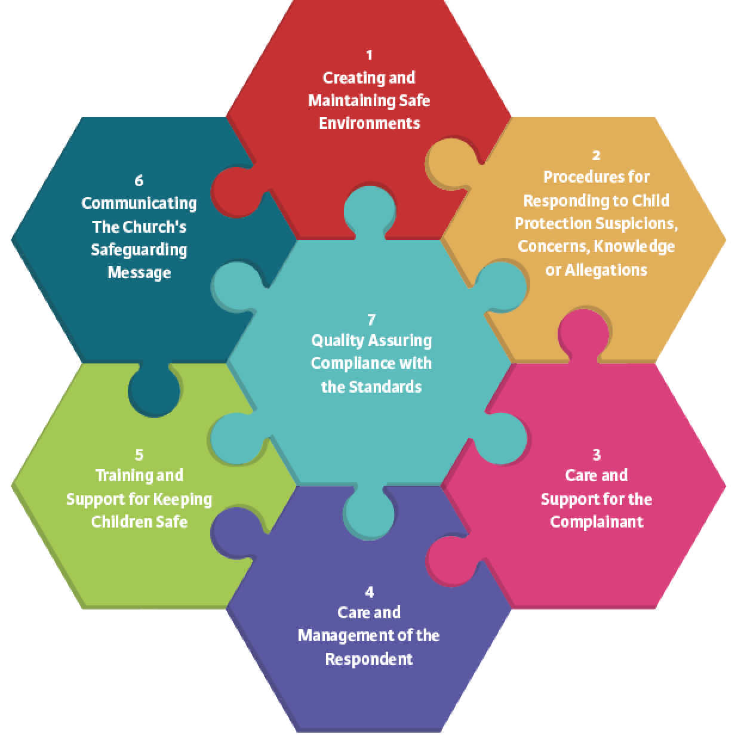

Slide 38
Standard 1
Safe recruitment (visiting priests and religious)
Children and adults codes of behaviour
Safe care (consent forms, supervision ratios)
Complaints
Information technology

Slide 39
Standard 2
How do I report?
Who do I tell?
What do I do if I receive a referral from someone overseas, and it is referred to me in Ireland?

Slide 40
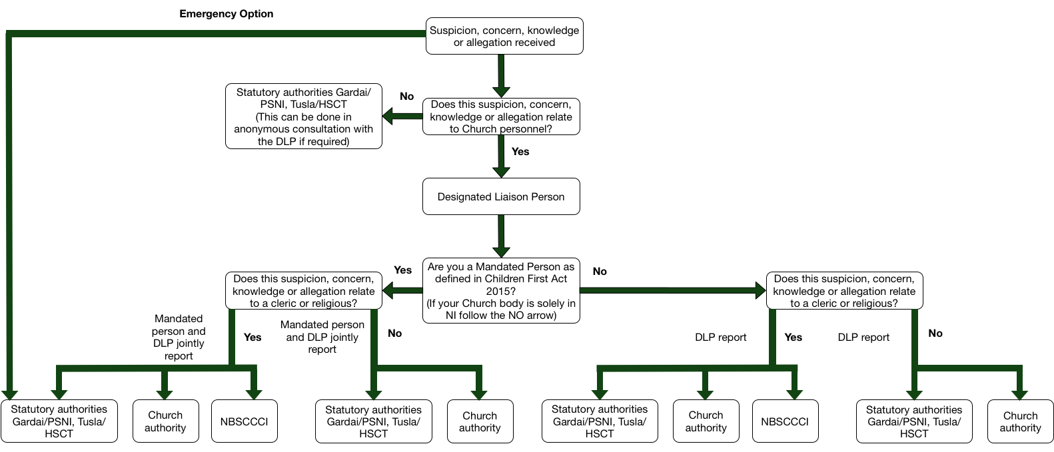

Slide 41
Mandated Persons
Mandated persons (as defined in the Children First Act 2015) are people who have contact with children and/or families and who, because of their qualifications, training and/or employment role, are in a key position to help protect children from harm
Each Church body should consult the full list of categories who are classified as mandated persons under Schedule 2 of the Children First Act 2015 to establish which members of Church personnel are classified as mandated persons

Slide 42
Mandated Persons
It should be understood that:
All clerics and religious who have any ministry are to be considered mandated persons
Volunteers are not mandated persons under the Children First Act 2015. However DLPs or Deputy DLPs who are volunteers are classed as mandated persons under Church standards.

Slide 43
Mandated Persons
On completion of this process the Church authority must retain a list of all mandated persons, and ensure this is kept up to date. In developing this list Tusla have advised that there should be a clear statement of the type of roles that a Church body are listing as mandated persons then a number of mandated persons that are in the Church body against each role. For Example
Clerics (25),
Pastoral Workers (50),
Religious (15) etc).
For more information see Guidance 2.1L

Slide 44
Standards 3 and 4
It is always appropriate to offer pastoral support to complainant no matter where in the world
Canon law applies internationally and therefore the presumption of innocence and canon norms apply anywhere in the world

Slide 45
Standard 5
Adapt the training programme to suit
Induction is always needed
Working with parents and guardians are always needed

Slide 46
Standard 6
Giving information to Church personnel and staff will always be required and making it relevant to the culture and language of the region you are operating in

Slide 47
Standard 7
How can we quality assure in the context of international missionary work?

Slide 48
Questions and Evaluation

