Slide 1
Trainers Update
26th May 2018

Slide 2
Welcome, Prayer and Introduction

Slide 3
Group Work

Slide 4
Group Work
Discuss the following:
What is working well in terms of the training programme?
What is more challenging or problematic?
What current resources are you using that you feel work and would be happy to share?

Slide 5
Reporting slide and difficult questions

Slide 6
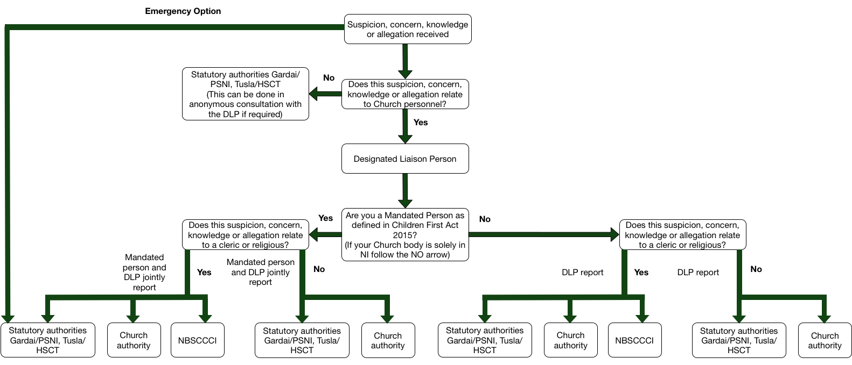

Slide 7
Mandated Person’s Session

Slide 8
Your Name
Your Church body

Slide 9
Opening Prayer or
Moment of Reflection

Slide 10
Group Contract

Slide 12
What is the National Board for Safeguarding Children in the Catholic Church in Ireland?
The NBSCCCI is a company limited by guarantee funded by the following two bodies:
Irish Catholic Bishops’ Conference
Association of Leaders of Missionaries and Religious of Ireland (AMRI)

Slide 13
What does the NBSCCCI do?
It offers advice and support on all aspects of child safeguarding and case management within the Catholic Church in Ireland
It assists with the development of policy, procedures and practice on all aspects of child safeguarding within the Catholic Church in Ireland
It monitors child safeguarding practice of constituent members within the Catholic Church in Ireland

Slide 14
Aims for the Session
Understanding what a mandated person is
Understanding your role as a mandated person

Slide 15
What is the difference between mandated persons and mandatory reporting?

Slide 16
All Church personnel north and south of the border are under the obligation to mandatorily report child protection allegations, knowledge, suspicions or concerns (except when it is notified to clerics during the sacrament of reconciliation).
Those classed as mandated persons are obliged under the law to pass on concerns to Tusla. The legal responsibility rests with them and while there are no criminal sanctions imposed by the Children First Act, there are administrative actions Tusla can take.

Slide 17
What is a mandated person?

Slide 18
Mandated Persons
Mandated persons (as defined in the Children First Act 2015) are people who have contact with children and/or families and who, because of their qualifications, training and/or employment role, are in a key position to help protect children from harm
The Congregation should consult the full list of categories who are classified as mandated persons under Schedule 2 of the Children First Act 2015 to establish which members of Church personnel are classified as mandated persons

Slide 19
Mandated Persons
It should be understood that:
All clerics and religious who have any ministry are to be considered mandated persons
Volunteers are not mandated persons under the Children First Act 2015. However DLPs or Deputy DLPs who are volunteers are classed as mandated persons under Church standards.

Slide 20
Mandated Persons
The Church authority must retain a list of all mandated persons, and ensure this is kept up to date.
In developing this list Tusla have advised that there should be a clear statement of the type of roles that the Church body are listing as mandated persons then a number of mandated persons that are in the Church body against each roles.
For example
Name and contact details of DLP
Clerics (25),
Pastoral Workers (50),

Slide 21
What is my role as a mandated person?

Slide 22
Mandated Persons
Mandated persons have two main legal obligations under the Children First Act 2015
To report harm of children, above a defined threshold, to Tusla
To assist Tusla, if requested, in assessing a concern which has been the subject of a mandated report

Slide 23
Mandated Persons
As a mandated person, under the legislation you are required to report any knowledge, belief or reasonable suspicion that a child has been harmed, is being harmed, or is at risk of being harmed.
The Act defines harm as assault, ill-treatment, neglect or sexual abuse, and covers single and multiple instances.

Slide 24
Mandated Persons
The reporting requirements under the Children First Act 2015 apply only to information that you as a mandated person, received or became aware of since the Act came into force.
However, if you have reasonable concern about past abuse, where the information came to your attention before the Act and there is possible continuing risk to children, you should report it to Tusla under the Children First Guidance 2017.

Slide 26
Reporting Forms
Two new forms from Tusla:
One for retrospective allegations (those when the complainant was a child but is now an adult)
One for current allegations (those when the complainant is a child)
The gardai will accept the forms from Tusla
The NBSCCCI form has remained the same, but now contains a joint signature space for mandated persons

Slide 27
Reporting Scenarios
For each scenario answer:
Is the person receiving the allegation a mandated person?
Who should this be reported to?
Which forms should be used?

Slide 28
Questions

Slide 29
Future Training Events

