Slide 1
Tuam Ecclesiastical Provincial Area Meeting
26th November 2018

Slide 2
Welcome
Archbishop Neary

Slide 3
Introductions and Purpose of the Meeting

Slide 4
Review of the Work of NBSCCCI

Slide 5
Guidance Updates
International Safeguarding
Re registration of trainers
Serious Incident Reviews
GDPR
Crisis Management
Lay Apostolates
John Paul II awards forms

Slide 6
Training
14th November 2018- Compassionate Response
Additional Ecclesiastical Provincial Area Meetings
Train The Trainers -Early 2019

Slide 8
Update so far
An initial consultation group consisting of formators from St. Patrick’s College Maynooth, the Pontifical Irish College in Rome and Redemptoris Mater in Dundalk, (all diocesan seminaries) was created to discuss and develop a detailed proposal for the Rectors and Trustees of the seminaries.
The proposal was sent to the rectors in September 2017 which was in turn shared with the trustees of each seminary.
Approval for the proposal was granted by the trustees of each seminary in November 2017.
Updated paper sent to formation group before being sent to Rectors and trustees for final sign off.
Work has continued to develop the modules and plan the cost and logistics for delivery to start in early 2019.

Slide 9
10 modules over 7 years…
Each module linked to the ratio fundamentalis formation stages
Each has core aims and assigned reading
Each will require the student to complete a reflective exercise
They include:
Child safeguarding policies and procedures (full day training delivered in parish by a trainer accredited with the NBSCCCI)
Historical and legislative context
Children’s rights
Theology of safeguarding children
The impacts of abuse
Good safeguarding practice and boundaries
Personal challenges when dealing with abuse
Communication and digital media
Spiritual healing
Leadership and safeguarding children

Slide 10
Review of Safeguarding Practice

Slide 11
Methodology trialed in two Church Bodies
Approved by Bishops’ Conference in June
Focus is on practice
Timeframe
Recruitment and training Reviewers
Data processing deeds

Slide 12
Information Sharing

Slide 13
Why do we need to share information?
The effective protection of a child often depends on the willingness of people to share and exchange relevant information appropriately.
It is critical that there is a clear understanding of the Church authority’s professional and legal responsibilities with regard to data protection, confidentiality and the exchange of information.

Slide 14
Why do we need to share information?
The deficiencies in both internal and external communication of essential child protection information by various Church authorities has been identified and criticised in a number of statutory reports, including the Ryan Report, the Ferns Report, the Report of the Commission of Investigation into the Catholic Archdiocese of Dublin (the Murphy Report), and the Cloyne Report. It is essential that the lessons from these reports are learned, and that improvements result in the sharing of information.

Slide 15
Situations when information must be shared
Sharing with the statutory authorities
All allegations, suspicions concerns or knowledge regarding child abuse that meet the threshold for reporting must be passed to the statutory authorities (Guidance 2.1A). Disclosure should include names, addresses, details of the allegations, and if the respondent has made an admission, where this information is available.
Sharing information with the NBSCCCI
Once the Church authority has signed the data processing deeds, information can be shared with the NBSCCCI for these three purposes:
a. Maintaining records of all allegations notified to it for monitoring purposes.
b. Retaining records relating to advice offered directly or through the NCMC.
c. Accessing records for audit function and cannot retain and/or use the personal information accessed during its audit for further purposes.

Slide 16
When sharing information with the NBSCCCI
This will be covered by 5 new Deeds and 5 MOUs
Deed for anonymous allegations against clerics and religious with accompanying MOU.
Deed for advice with accompanying MOU (but if you want advice you must provide full information).
Deed for NCMC with accompanying MOU.
Deed for Review with accompanying MOU.
Deed for support with case management records with accompanying MOU.

Slide 17
When informing us of an allegation
The referral form must be used, telling us through advice or NCMC is NOT notifying us that an allegation has been received.
When you use the referral form:
The Complainant’s details are anonymised
Name of respondent is anonymised
Details you need to give (as long as it doesn’t directly identify the person):
DOB
Role in Church body
Current contact with children
Dates/times the incident occurred
The type of abuse
Any witnesses
Whether the complainant knows this referral is being made

Slide 18
Situations when information can be shared
As part of an investigation by the statutory authorities
During the course of an investigation, if the Gardaí́/PSNI request information from a file, every effort should be made to cooperate. However, careful consideration should be given to sharing the following without consent:
Legal advice obtained by the Church authority may be privileged and may not be shared without the consent of the Church authority;
Assessment reports may require the permission of the
author and the respondent.

Slide 19
Situations when information can be shared
Between Church bodies
There may be occasions when information between Church bodies is required.
Under canon law, faculties to minister as a priest in public can only be granted by a bishop.
It is therefore appropriate that information is shared between a provincial of an ordained cleric from a religious order/congregation when an allegation of child abuse is made against that priest, so that the bishop can determine whether or not to withdraw faculties.
As each of these situations is unique, the decision whether and what
to share with another Church body will be on a case-by-case basis.

Slide 20
Questions which may help making this
determination
Does the recipient have a legitimate interest in receiving this information?
What is the justification for sharing information?
Is there a risk of harm to an identified or unidentified child if such information is not shared?
Can permission be obtained from the respondent to share information?
Should the respondent be informed that the information is being shared?
Is the respondent in public ministry as a priest and has faculties from the bishop?
Is the respondent in the public ministry of a Church body?
Should information about the complainant be redacted?

Slide 21
Web Site Requirements

Slide 22
Web Site
Websites must contain
Policy statement (Page 8 ) – clearly on display not requiring any clicks to access
Link to the Child Safeguarding Policy
Child Safeguarding Statement- Tusla requirement for those ministering with children
DLP names and up to date contact information
Procedures- either yours or link to the NBSCCCI (if the later clear statement that you are following the NBSCCCI)

Slide 23
Example website statement for those following NBSCCCI guidance
For the procedures to implement the child safeguarding policy, the INSERT NAME OF CHURCH BODY follows the guidance of the National Board for Safeguarding Children in the Catholic Church in Ireland available here www.safeguarding.ie/index.php/guidance

Slide 24
Lay Apostolates

Slide 25
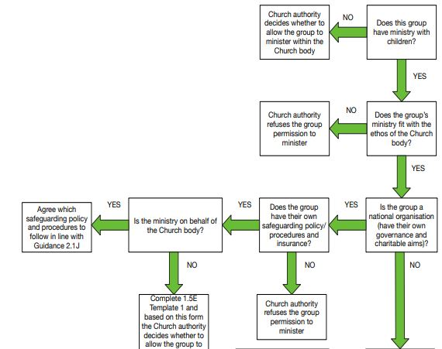
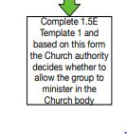

Slide 26
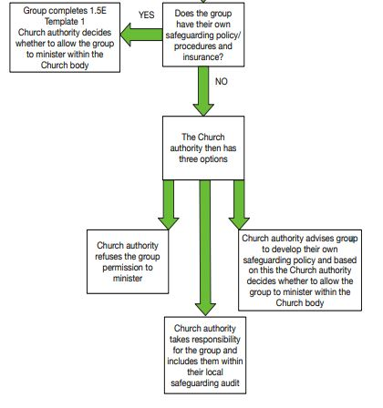

Slide 27
Issues from the audience

