Slide 1
Armagh Ecclesiastical Provincial Area Meeting
19th September

Slide 2
Welcome
Archbishop Martin

Slide 3
Introductions and Purpose of the Meeting

Slide 4
Review of the Work of NBSCCCI

Slide 5
Guidance Updates
International Safeguarding
Re registration of trainers
Serious Incident Reviews
GDPR
Crisis Management
Lay Apostolates
John Paul II Awards forms

Slide 6
Training
26th September-Working Safely with Children
10th October-International Missionary Work
26th and 27th of October-National Conference
14th November- Compassionate Response
Additional Ecclesiastical Provincial Area Meetings
Train The Trainers -Early 2019

Slide 7
Review of Safeguarding Practice

Slide 8
Methodology trialed in two Church bodies
Approved by Bishops’ Conference in June
Focus is on practice
Timeframe
Recruitment and training reviewers
Data processing deeds

Slide 9
Information Sharing

Slide 10
Why do we need to share information?
The effective protection of a child often depends on the willingness of people to share and exchange relevant information appropriately.
It is critical that there is a clear understanding of the Church authority’s professional and legal responsibilities with regard to data protection, confidentiality and the exchange of information.

Slide 11
Why do we need to share information?
The deficiencies in both internal and external communication of essential child protection information by various Church authorities has been identified and criticised in a number of statutory reports, including the Ryan Report, the Ferns Report, the Report of the Commission of Investigation into the Catholic Archdiocese of Dublin (the Murphy Report), and the Cloyne Report. It is essential that the lessons from these reports are learned, and that improvements result in the sharing of information.

Slide 12
Situations when information must be shared
Sharing with the statutory authorities
All allegations, suspicions concerns or knowledge regarding child abuse that meet the threshold for reporting must be passed to the statutory authorities (Guidance 2.1A). Disclosure should include names, addresses, details of the allegations, and if the respondent has made an admission, where this information is available.
Sharing information with the NBSCCCI
Once the Church authority has signed the data processing deeds, information can be shared with the NBSCCCI for these three purposes:
a. Maintaining records of all allegations notified to it for monitoring purposes
b. Retaining records relating to advice offered directly or through the NCMC;
c. Accessing records for audit function and cannot retain and/or use the personal information accessed during its audit for further purposes.

Slide 13
When sharing information with the NBSCCCI
Complainant’s details are anonymised
Name of respondent is anonymised
Details you need to give:
DOB
Role in Church body
Current contact with children
Dates/times the incident occurred
The type of abuse
Any witnesses
Whether the complainant knows this referral is being made

Slide 14
Situations when information can be shared
As part of an investigation by the statutory authorities
During the course of an investigation, if the Gardaí́/PSNI request information from a file, every effort should be made to cooperate. However, careful consideration should be given to sharing the following without consent:
Legal advice obtained by the Church authority may be privileged and may not be shared without the consent of the Church authority;
Assessment reports may require the permission of the
author and the respondent

Slide 15
Situations when information can be shared
Between Church bodies
There may be occasions when information between Church bodies is required.
Under canon law, faculties to minister as a priest in public can only be granted by a bishop.
It is therefore appropriate that information is shared between a provincial of an ordained cleric from a religious order/congregation when an allegation of child abuse is made against that priest, so that the bishop can determine whether or not to withdraw faculties.
As each of these situations is unique, the decision whether and what
to share with another Church body will be on a case-by-case basis.

Slide 16
Questions which may help making this
determination
Does the recipient have a legitimate interest in receiving this information?
What is the justification for sharing information?
Is there a risk of harm to an identified or unidentified child if such information is not shared?
Can permission be obtained from the respondent to share information?
Should the respondent be informed that the information is being shared?
Is the respondent in public ministry as a priest and has faculties from the bishop?
Is the respondent in the public ministry of a Church body?
Should information about the complainant be redacted?

Slide 17
Web Site Requirements

Slide 18
Web Site
Websites must contain
Policy statement (Page 8 ) – clearly on display not requiring any clicks to access
Link to the Child Safeguarding Policy
Child Safeguarding Statement- Tusla requirement for those ministering with children
DLP names and up to date contact information
Procedures- either yours or link to the NBSCCCI (if the later clear statement that you are following the NBSCCCI)

Slide 19
Example website statement for those following NBSCCCI guidance
For the procedures to implement the child safeguarding policy, the INSERT NAME OF CHURCH BODY follows the guidance of the National Board for Safeguarding Children in the Catholic Church in Ireland available here www.safeguarding.ie/index.php/guidance

Slide 20
Lay Apostolates

Slide 21
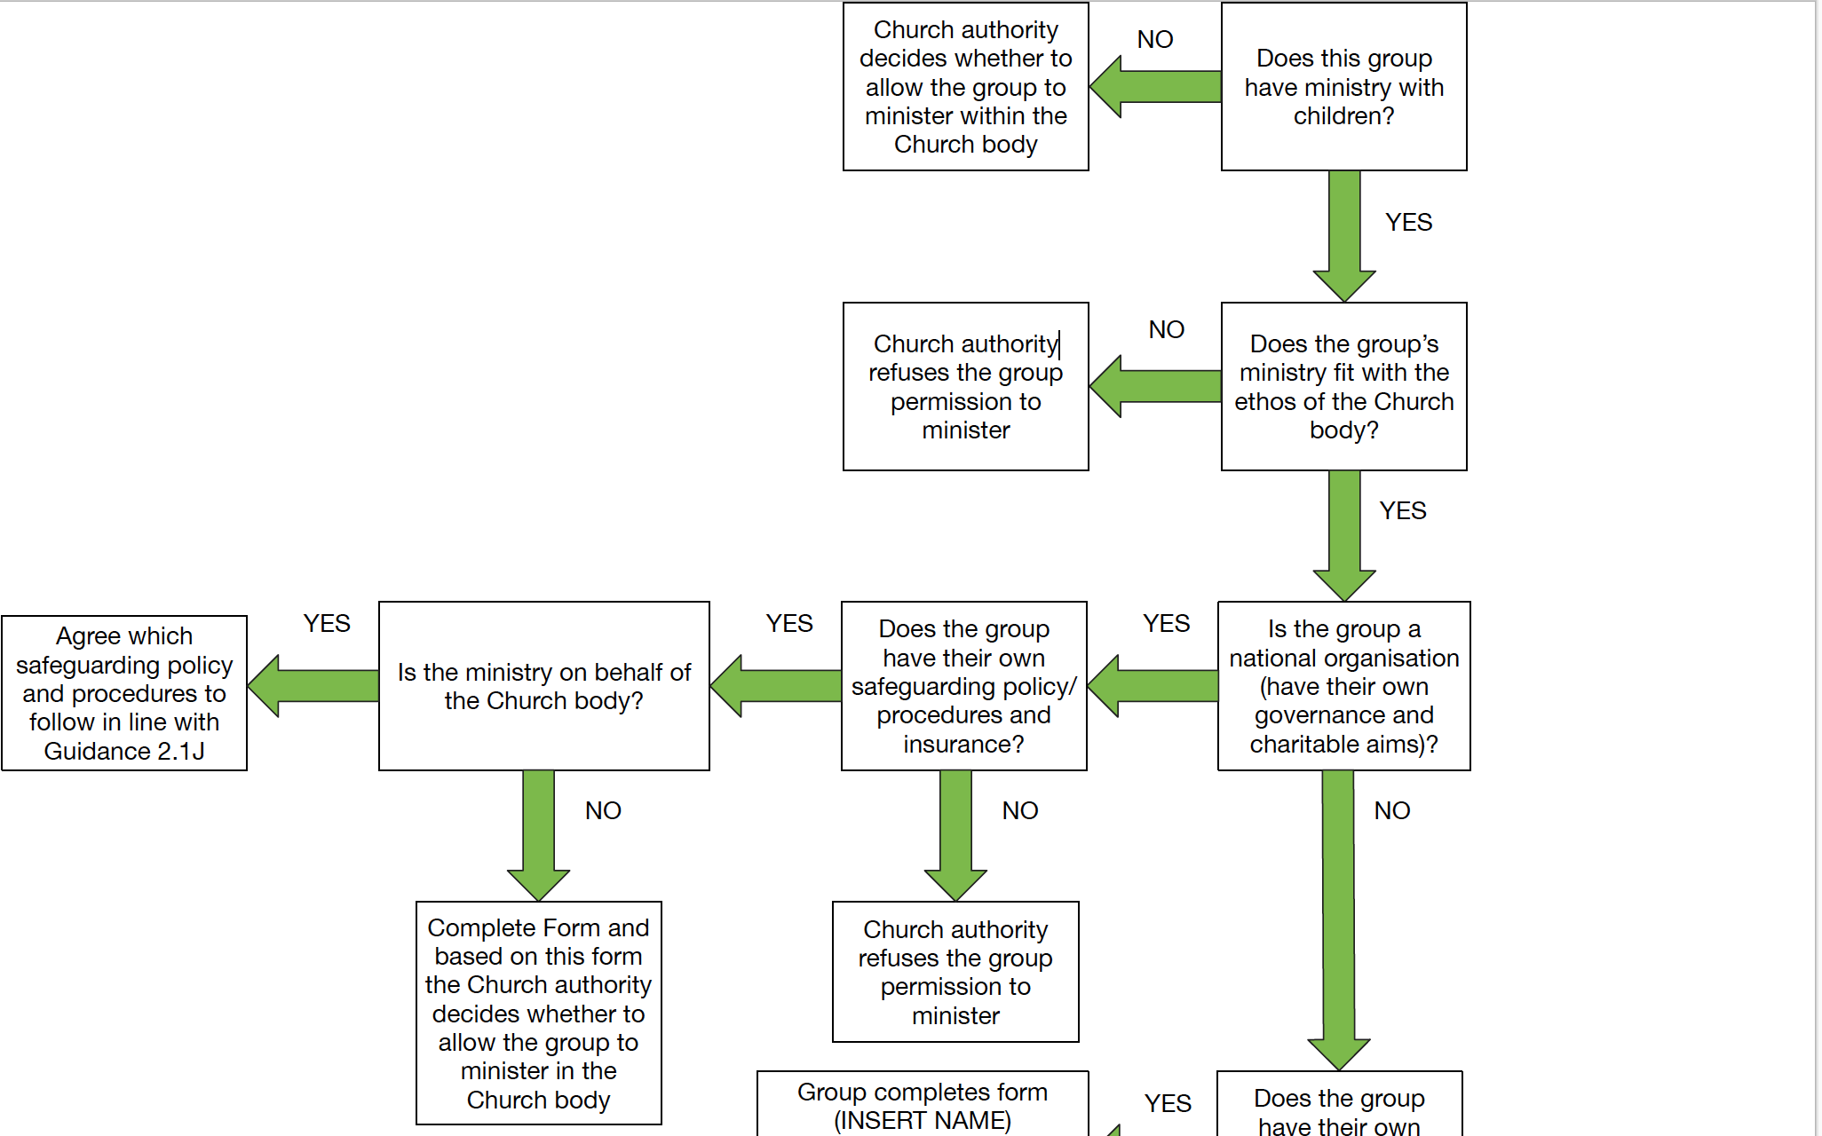

Slide 22
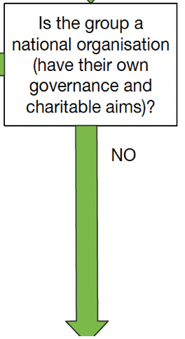
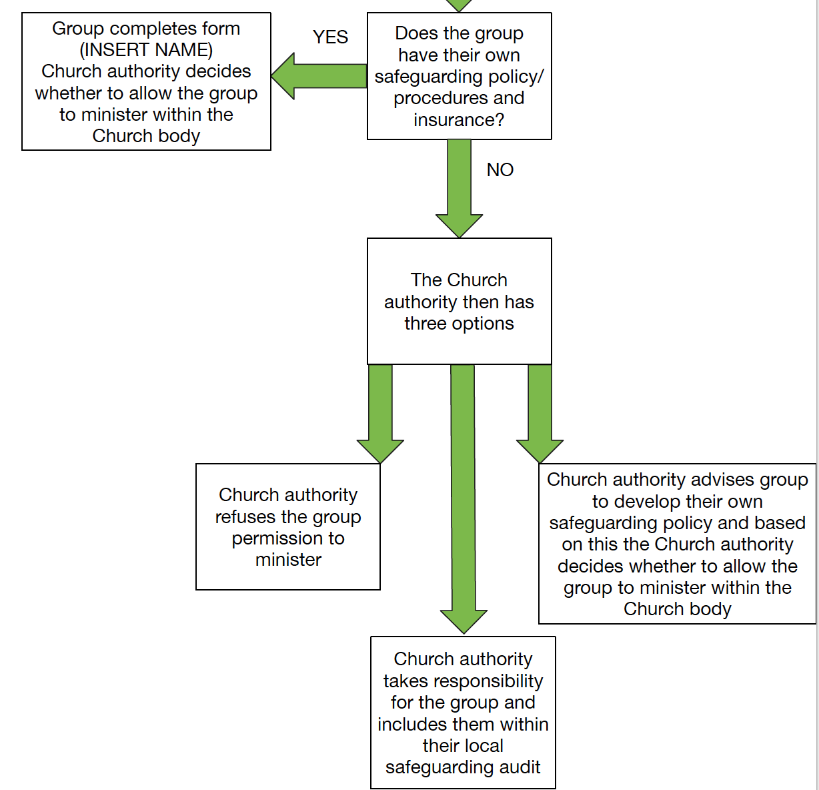

Slide 23
Issues from the audience

